Slide 1
New Collider Searches
for
Axion-like Particles Coupling to Gluons
Based on arXiv:2006.05302 by
Mojtaba Mohammadi Najafabadi
Gholamhossein Haghighat
Daruosh Haji Raissi
Presented by
Gholamhossein Haghighat
Aug. 2020
IPM
School of Particles and Accelerators

Slide 2
Outline
U(1) problem and strong CP problem
A
Peccei-Quinn’s solution to the strong CP problem
Axion-like Particles (ALPs)
ALP decay modes
ALP-gluon coupling and ALP production
Event generation and preselection
Signal/background discrimination
Constraints on the ALP-gluon coupling

Slide 3
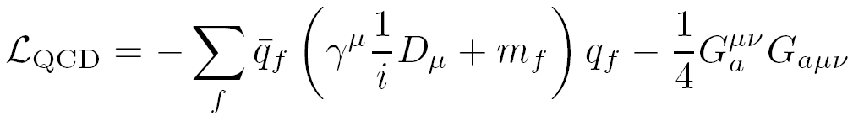














U(1) problem and strong CP problem
A
spontaneously
broken
spontaneously
broken
baryon number
triplet of
Nambu-Goldstone bosons
Solution: U(1) is never a symmetry
QCD vacuum
U(1) problem
A
A
Strong CP problem
1

Slide 4





Peccei-Quinn’s solution to the strong CP problem
Anomalous U(1) symmetry
Axion field a
PQ
Spontaneously broken
CP conserving
Strong CP problem
2

Slide 5

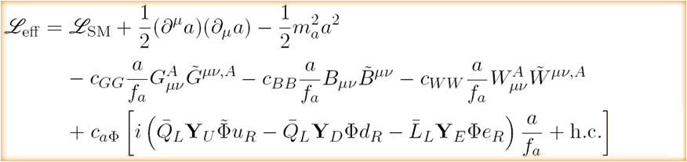



Axion-like Particles (ALPs)
Axion
Axion-like Particles
Motivations
Strong CP problem
Observed baryon asymmetry
Dark matter
Neutrino mass problem
3

Slide 6
















ALP decay modes
dominant at
pair production thresholds
dominant if
LO
2 loop
1 loop
Decay length of light ALPs
3000
probability that the ALP decays inside the detector:
4

Slide 7

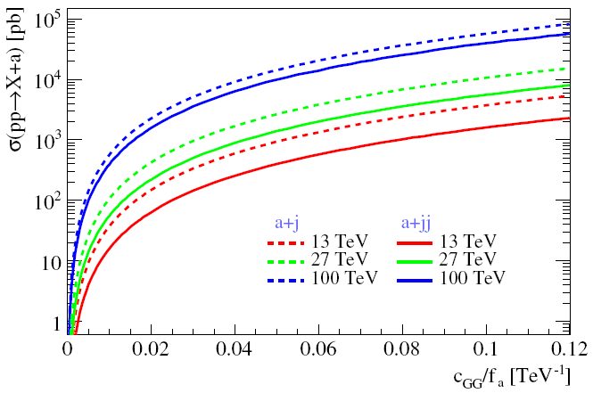
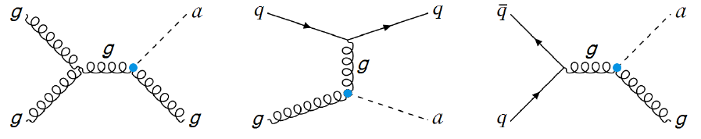
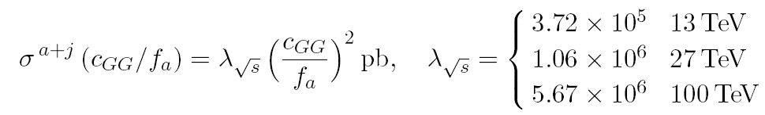


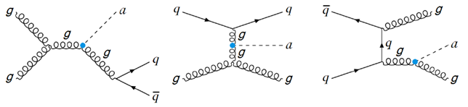
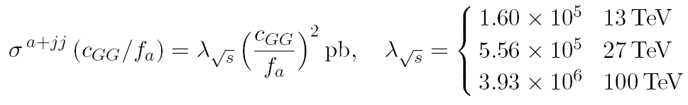



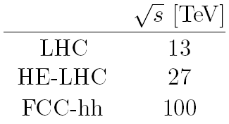


ALP-gluon coupling and ALP production
Search for processes sensitive to ALP-gluon coupling
Dominant SM backgrounds
5

Slide 8

Event generation and preselection
c is the only
non-vanishing coupling
GG
requirements
1 or 2 mono-jet
number of reconstructed jets =
MadGraph5_aMC@NLO
( , )
2 or 3 di-jet
p > 30 GeV
| | < 2.5
T
T
E > 30 GeV
miss
Pythia 8.2.43
veto
Delphes 3.4.2
1 or more isolated photons
( )
p > 10 GeV
T
( )
1 or more isolated e or μ
p > 10 GeV
FastJet (anti-k algorithm – 0.4)
T
t
0.12 photons, electrons
I <
rel
0.25 muons
T
EFT validation (2E < f )
miss
a
6

Slide 9
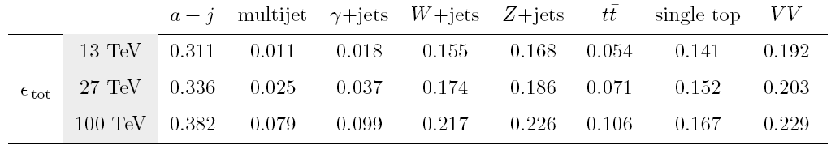
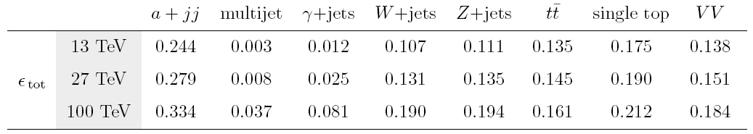
Event generation and preselection
7

Slide 10



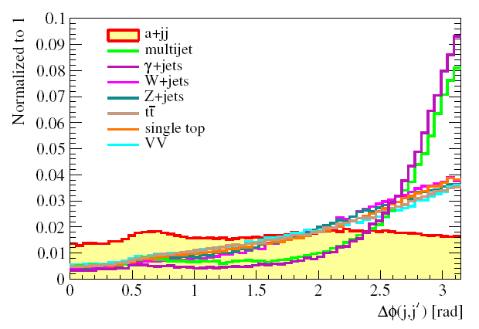
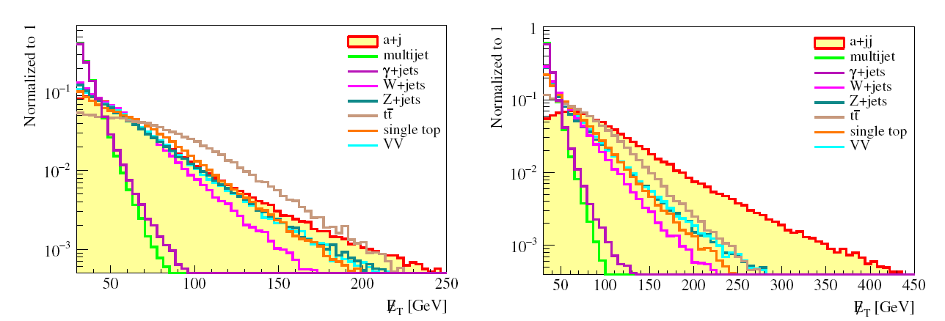




Signal/background discrimination
Multivariate technique : Boosted Decision Trees (BDT) algorithm
Discriminating variables
Missing transverse energy
Scalar transverse energy sum
Scalar transverse energy sum
Azimuthal separation between the missing transverse energy and the hardest jet
Azimuthal separation between the missing transverse energy and the hardest jet
mono-jet
di-jet
Transverse momentum and pseudorapidity of the hardest jet
Transverse momentum and pseudorapidity of the hardest jet
Only di-jet analysis
Only di-jet analysis
Azimuthal separation between the two hardest jets
Azimuthal separation between the two hardest jets
Transverse momentum and pseudorapidity of the second hardest jet
Transverse momentum and pseudorapidity of the second hardest jet
8

Slide 11
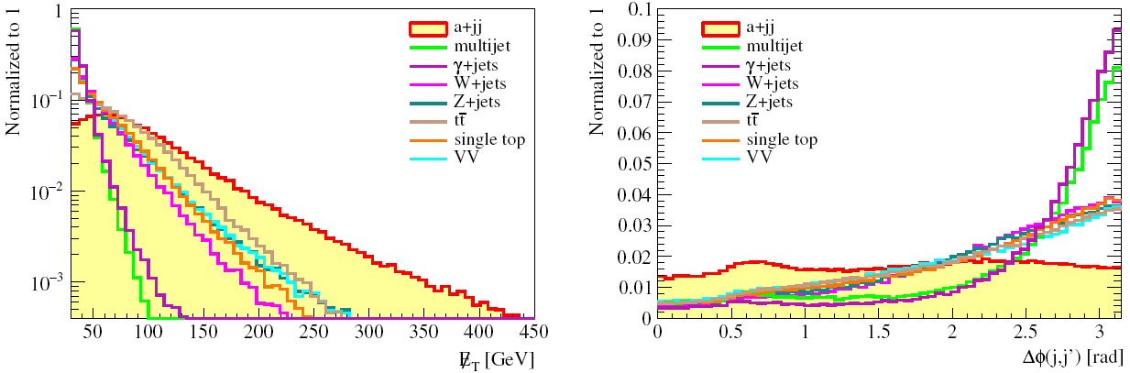
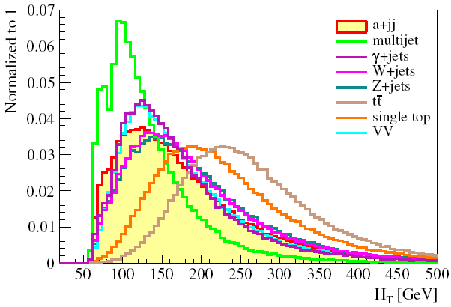
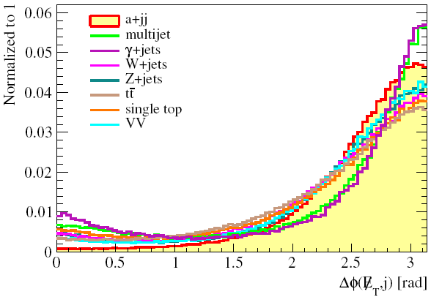
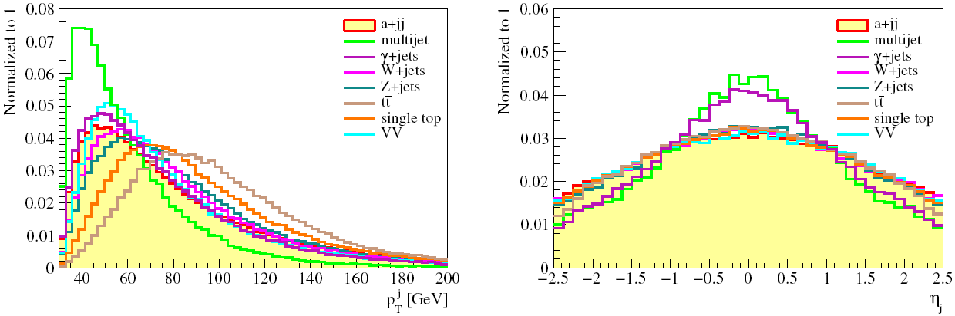
di-jet
13 TeV
9

Slide 12
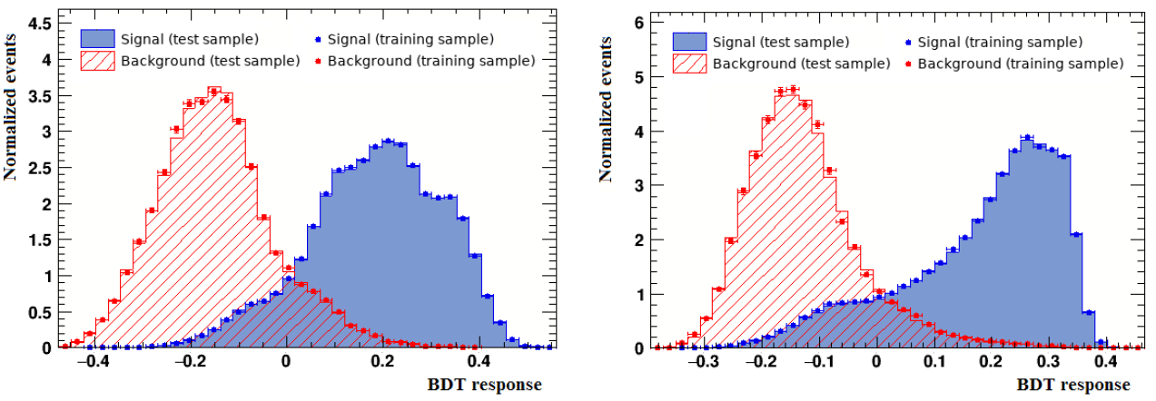
Signal/background discrimination
Classifier response
mono-jet
di-jet
10

Slide 13
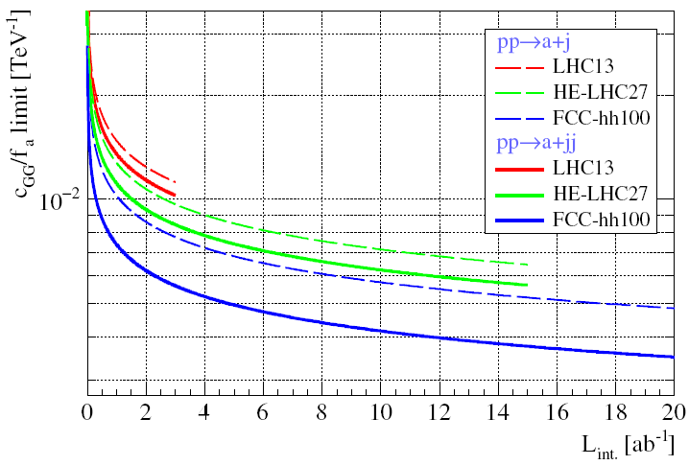
Constraints on the ALP-gluon coupling
11

Slide 14
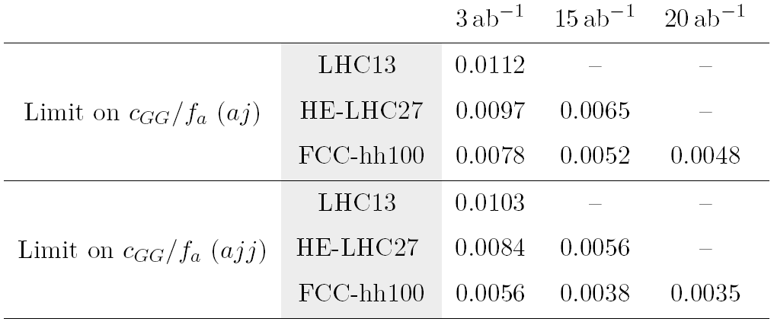
Constraints on the ALP-gluon coupling
Current LHC limit: 0.025 TeV
-1
12

Slide 15
Thank you

