Slide 1




Update on the Electron Driver Linac for the CLIC Positron Source
Umut Keskin^{1,2,3}
¹Ankara Institute of Accelerator Technologies
²CERN
³Abant Izzet Baysal University
CLIC Beam Physics Meeting - CERN, 2 November 2017
Dr. Andrea Latina²
Dr. Daniel Schulte²
Prof. Dr. Haluk Denizli^{1,2,3}

Slide 2
Outline
CLIC Beam Physics Meeting - CERN, 2 November 2017
Introduction
Beam Parameters and FoDo Cell Designs
Impact of Misalignments
Conclusion
Outlook

Slide 3
CLIC Beam Physics Meeting - CERN, 2 November 2017
CLIC Beam Physics Meeting - CERN, 2 November 2017
Introduction
Beam Parameters and FoDo Cell Designs
Impact of Misalignments
Conclusion
Outlook

Slide 4
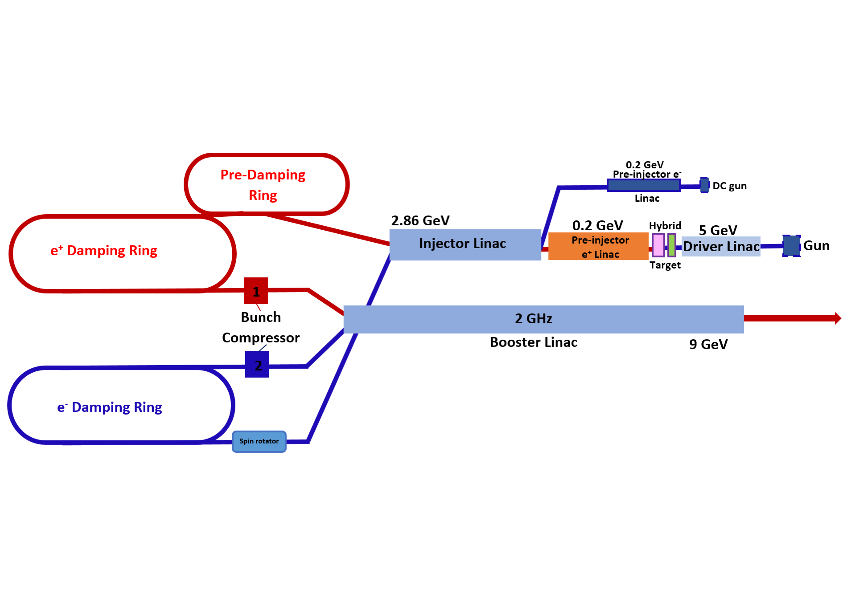
Introduction
CLIC Beam Physics Meeting - CERN, 2 November 2017
Our motivation for this work is to design and optimize the primary 5 GeV e⁻ linac in the CLIC positron source.
This is an important task because this linac will consume higher power than any other linac in the CLIC main beam injector complex.
Also, explore further information about this machine with optimizing it by creating new set of lattices.

Slide 5
CLIC Beam Physics Meeting - CERN, 2 November 2017
Introduction
Beam Parameters and FoDo Cell Designs
Impact of Misalignments
Conclusion
Outlook

Slide 6
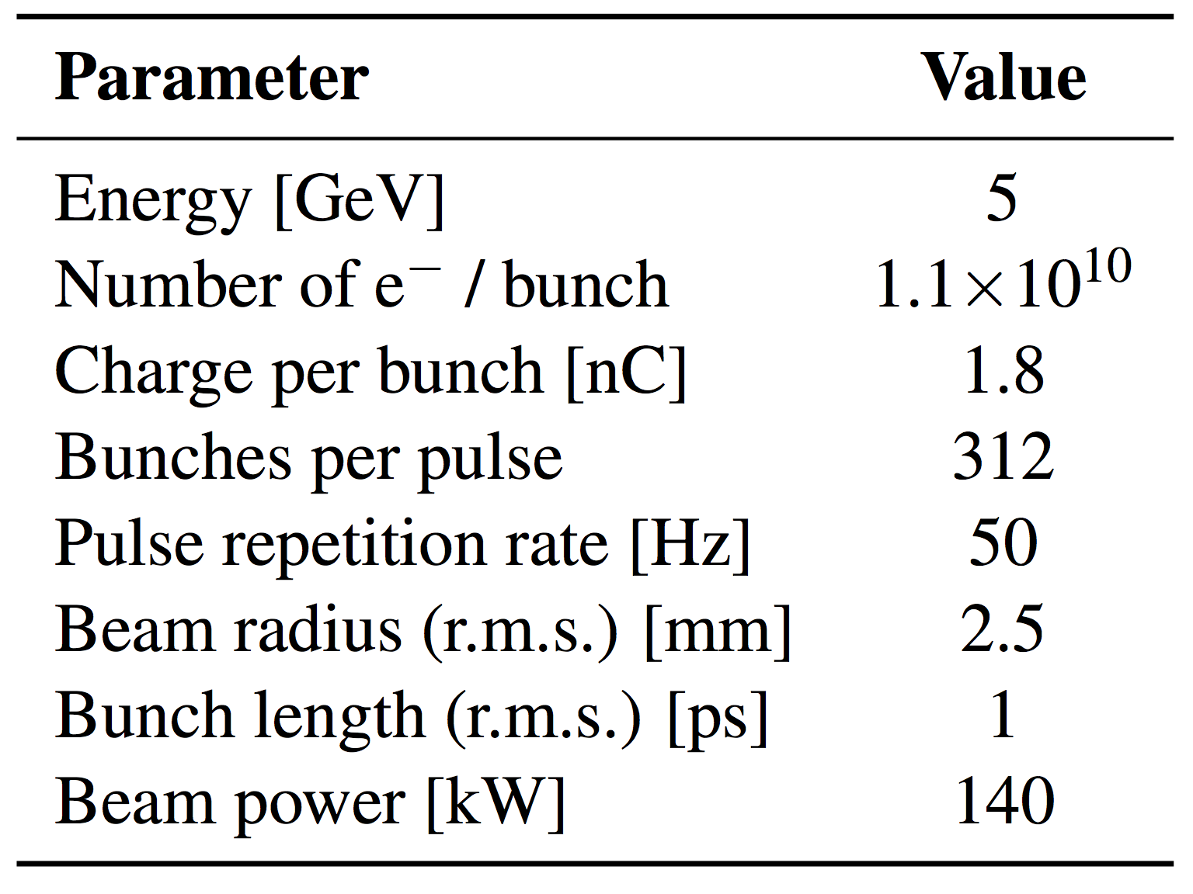
Beam Parameters
  BEAM PARAMETERS FOR OUR DESIGNS
  BUNCH PARAMETERS
  Bunch length, 𝜎_{z} = 300 µm
  Energy spread = 1%
  Number of particles : 1x10¹⁰
  Beam radius = 2.5 mm
  ε _{x} = 1000x10⁻⁷ m.rad
  ε _{y} = 1000x10⁻⁷ m.rad
  RF PARAMETERS
  Gradient = 20 MV/m
  Cavity Length = 1.5 m
  f = 2.0 GHz
  Phase advance per cell = 2π / 3
  Filling factor = 74.5%
  LATTICE PARAMETERS
  Phase advance, µ = 90º
  Quadrupole length = 0.2m
  Drift length = 0.25 m
  Beam pipe = 2 cm
  Quadrupole radius = 5 cm
CLIC Beam Physics Meeting - CERN, 2 November 2017
Primary 5 GeV e⁻ beam parameters from CLIC-CDR.

Slide 7
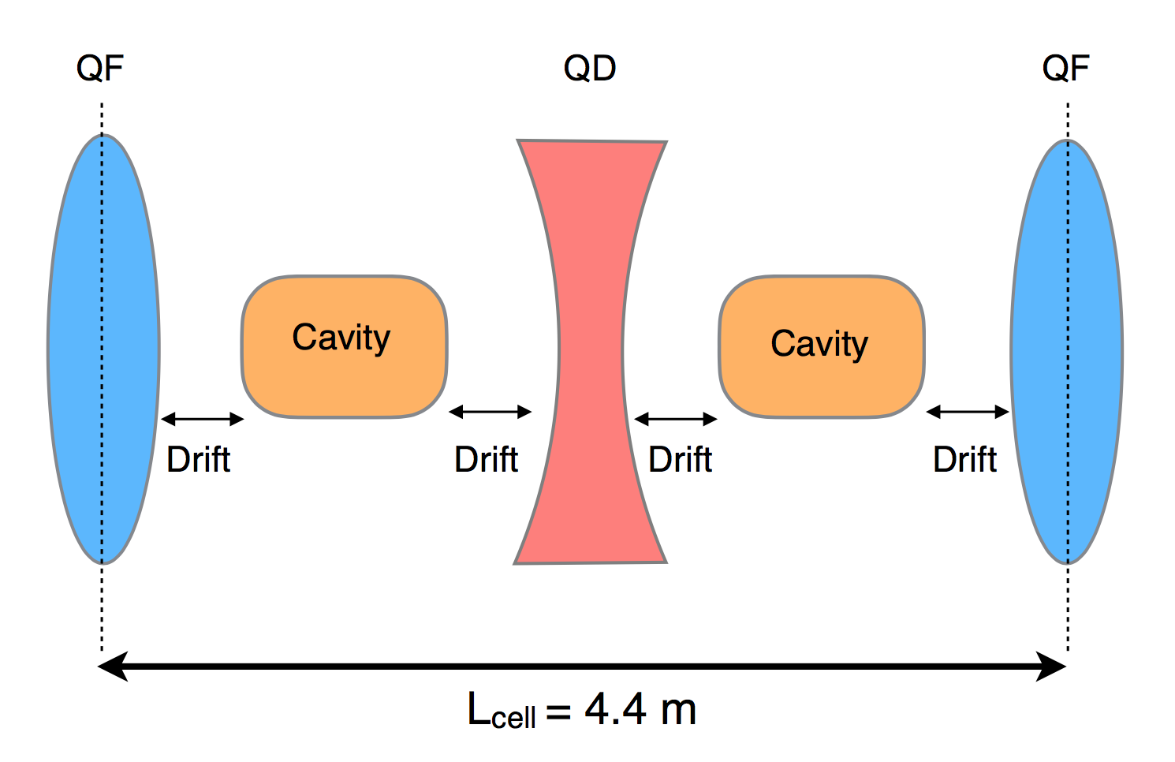
FoDo Cell Designs
CLIC Beam Physics Meeting - CERN, 2 November 2017
x12
x12
x3
x3
x6
x6
x9
x9
M
M
M
M
M
354 m
Target
5 GeV Linac with 5 FoDo cell sections :
2 FoDo cells with two accelerating structure
2 FoDo cells with six accelerating structures
2 FoDo cells with twelve accelerating structures
3 FoDo cells with eighteen accelerating structures
3 FoDo cells with twenty four accelerating structures
Total length of the linac = 354 m
Total number of quadrupoles = 45 (29 Quadrupoles from beamline, 16 Quadrupoles from matching sections)

Slide 8
FoDo Cell Designs: Optimization
CLIC Beam Physics Meeting - CERN, 2 November 2017
5 GeV Linac with 5 FoDo cell sections :
Little fluctuation in emittance evolution through beamline because of the very long FoDo cells at the fifth part of linac (~44m) for default beam with no misalignments.
Emittance growths → Around 0.9% at “x” and 0.5% at “y” (energy spread = 1% in the simulations)

Slide 9
FoDo Cell Designs
CLIC Beam Physics Meeting - CERN, 2 November 2017
x3
x3
x6
x6
x9
x9
M
M
M
M
346 m
Target
5 GeV Linac with 4 FoDo cell sections :
2 FoDo cells with two accelerating structure
2 FoDo cells with six accelerating structures
2 FoDo cells with twelve accelerating structures
7 FoDo cells with eighteen accelerating structures
Total length of the linac = 346 m
Total number of quadrupoles = 43 (30 Quadrupoles from beamline, 13 Quadrupoles from matching sections)

Slide 10
FoDo Cell Designs: Optimization
CLIC Beam Physics Meeting - CERN, 2 November 2017
5 GeV Linac with 4 FoDo cell sections :
Very little fluctuation in emittance evolution through beamline for default beam with no misalignments.
Emittance growths → Around 0.1% at “x” and 0.5% at “y” (energy spread = 1% in the simulations)

Slide 11
FoDo Cell Designs: About 3 GeV Alternative Option
CLIC Beam Physics Meeting - CERN, 2 November 2017
3 GeV Alternative Linac with 4 FoDo cell sections :
About ongoing studies for the positron source and target studies a 3 GeV linac version instead of 5 GeV one was considered.
This is a preliminary design for the 3 GeV linac which cut from the 5 GeV version with one different last section which includes FoDo cells with 10 accelerating structures between two quadrupoles.

Slide 12
FoDo Cell Designs: Comparing Old and New Designs
CLIC Beam Physics Meeting - CERN, 2 November 2017
 | 5 GeV old design with three sections | 5 GeV new design with five sections | 5 GeV new design alternative with four sections | 3 GeV preliminary design with four sections
Accelerating Gradient | 30 MV/m | 20 MV/m | 20 MV/m | 20 MV/m
# of Quadrupoles | 61 | 45 | 43 | 35
Total Length | 242.5 m | 342 m | 334 m | 225 m
Filling Factor | 71.5 % | 72.4 % | 74.5 % | 66.7%

Slide 13
Matching: Required Beam Spot Size for Target
CLIC Beam Physics Meeting - CERN, 2 November 2017
With a free matching section at the end of the linac, we can also match required beam spot size for the target as mentioned from the CLIC-CDR report which was 2.5 mm radius.
Also this size could be optimized and matched for the required parameters for the different target studies.

Slide 14
CLIC Beam Physics Meeting - CERN, 2 November 2017
Introduction
Beam Parameters and FoDo Cell Designs
Impact of Misalignments
Conclusion
Outlook

Slide 15
Impact of Misalignments
CLIC Beam Physics Meeting - CERN, 2 November 2017
Elements such as quadrupoles, cavities and BPMs were misaligned randomly ;
  100 µm initial offset forbeam
  100 µm random misalignment for each quadrupole
  And 100 µm random misalignment for all elements at once (cavities, BPMs and quadrupoles)
For correcting these misalignments ;
  BPMs were set to 100 µm resolution
  And after each quadrupole, dipole correctors were added to the beamline for correction

Slide 16
Impact of Misalignments
CLIC Beam Physics Meeting - CERN, 2 November 2017
5 GeV Linac with 5 FoDo cell sections :
These graphs show simulations of 100 machines’ average.
100 µm offset for the initial beam.
1 to 1 correction works well.
100 µm BPM resolution was used.

Slide 17
Impact of Misalignments
CLIC Beam Physics Meeting - CERN, 2 November 2017
5 GeV Linac with 5 FoDo cell sections :
These graphs show simulations of 100 machines’ average.
100 µm random misalignment for each quadrupole in the beamline and it is pretty much affected.
1 to 1 correction works very well.
100 µm BPM resolution was used.

Slide 18
Impact of Misalignments
CLIC Beam Physics Meeting - CERN, 2 November 2017
5 GeV Linac with 5 FoDo cell sections :
When all the elements in the beamline were misaligned all together about 100 µm randomly, emittance was grown about ~50% at x and ~90% at y.
These emittance growths are very big but we can correct these misalignments by using dipoles after each quadrupole and 100 µm resolution BPMs for monitoring them.
These simulations also shows 100 machines’ average

Slide 19
Impact of Misalignments
CLIC Beam Physics Meeting - CERN, 2 November 2017
5 GeV Linac with 4 FoDo cell sections :
These graphs show simulations of 100 machines’ average.
100 µm offset given for the initial beam.
1 to 1 correction works well.
100 µm BPM resolution was used.

Slide 20
Impact of Misalignments
CLIC Beam Physics Meeting - CERN, 2 November 2017
5 GeV Linac with 4 FoDo cell sections :
These graphs show simulations of 100 machines’ average.
100 µm random misalignment for each quadrupole in the beamline and it is pretty much affected.
1 to 1 correction works very well.
100 µm BPM resolution was used.

Slide 21
Impact of Misalignments
CLIC Beam Physics Meeting - CERN, 2 November 2017
5 GeV Linac with 4 FoDo cell sections :
When all the elements in the beamline were misaligned all together about 100 µm randomly, emittance was grown about ~40% at x and ~80% at y.
These growths are very big but we can correct these misalignments by using dipoles after each quadrupole and 100 µm resolution BPMs for monitoring them.
These simulations also shows 100 machines’ average in the simulations.

Slide 22
CLIC Beam Physics Meeting - CERN, 2 November 2017
Introduction
Beam Parameters and FoDo Cell Designs
Impact of Misalignments
Conclusion
Outlook

Slide 23
Conclusion
CLIC Beam Physics Meeting - CERN, 2 November 2017
Optimization with multiple designs and lower gradient than the previous version for the 5 GeV electron driver linac for CLIC positron source were done.
Impacts of misalignments on the beamline for these designs were also studied.
With these different designs with different parameters, number of quadrupoles that used in the beamline were slightly reduced and this time 20 MV/m gradient has been considered.
Beam stressed to the edge with high ß function scales with factor 10 which effects and growth emittance slightly through the machine if we have any misalignment like 100 µm for random elements.
Required target beam spot size studies were also done by using PLACET and can be optimized to any value for further target studies.

Slide 24
CLIC Beam Physics Meeting - CERN, 2 November 2017
Introduction
Beam Parameters and FoDo Cell Designs
Impact of Misalignments
Conclusion
Outlook

Slide 25
Outlook
CLIC Beam Physics Meeting - CERN, 2 November 2017
Aim of the current work about this study is to calculate power consumption of one structure in the machine and how power consumption scales with current.
Also, power consumption for all the machine designs and trying to calculate how much it costs approximately.
With further calculations, following optimizations will aim for lowering the power consumption and approximate cost of this linac.

Slide 26
CLIC Beam Physics Meeting - CERN, 2 November 2017
THANK YOU
FOR YOUR ATTENTION !

