Slide 1
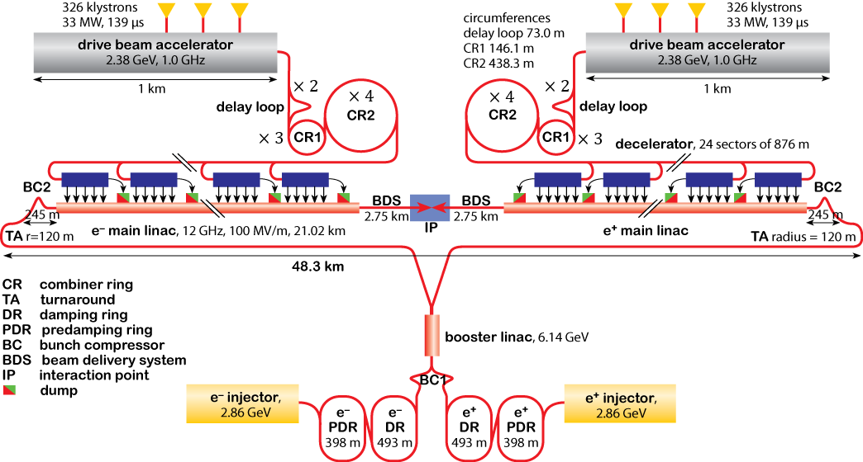
1. Project I
1.1 Introduction to CLIC (Compact Linear Collider)
Drive Beams
The DBs ($e^{−}e^{−}$) first are generated in long trains but low current pulses ($2.4GeV$, 4.2A , $140μs$, 0.5 GHz).
Using bunch multiplication technique DB arrives to short trains but high current pulses (101 A , 244 ns, 12 GHz).
The sub pulses are decelerated in 24 sectors to produce the RF power needed for the main beam acceleration.
The MBs ($e^{+}e^{−}$) are generated initially from in the MB injectors (6.14 GeV, 1 A, 156 ns, 2 GHz).
MBs are injected to the main LINACs excited by DB and accelerated up to 3TeV.
Main Beams
$$1$$

Slide 2
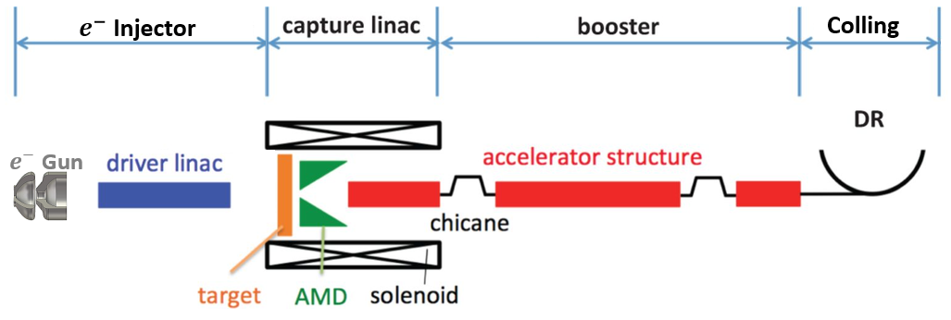
1. Project I
1.2 CLIC Positron Source
CLIC Positron Source
Target
$e^{−}$injector: A high current $e^{−}$ beam is generated (2 GeV, 5 A, 312 ns, 50 Hz).
AMD
Has to be designed very carefully to produce a high quality $e^{+}$ beam from incident $e^{−}$ beam.
Capture Linac:
Acc.
Sol.
Chicanes: More compression
DR: decreases the $e^{+}$ beam emittance hundreds times and duplicates its frequency.
Booster:
2 GeV, 1 GHz, 1 A $e^{+}$ beam.
Accelerators: More acceleration
$$2$$

Slide 3
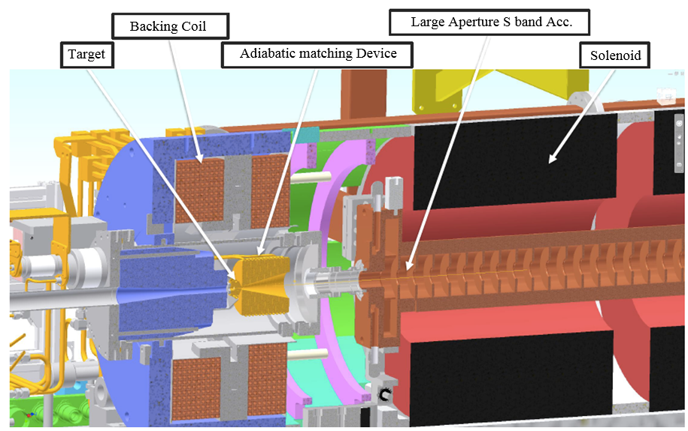
1. Project I
1.2 CLIC Positron Source
Capture Linac
Sol: Preserves the beam quality against the space charge effect.
AMD: focuses the $e^{+}e^{−}$ pairs in order to be efficiently capture/remove downstream.
Acc: In a right structure, phase and gradient removes $e^{−}$s but accelerates efficiently $e^{+}s$ up to 200 MeV
Target: The $e^{−}$ beam collides to a hybrid tungsten target and produces $e^{+}e^{−}$ pairs.
BC: Removes the magnetic field on target and preserve the emittance of $e^{+}e^{−}$ beams.
3

Slide 4
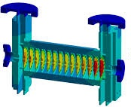
1. Project I
1.3 BD Simulations and Optimization of Acc. Structure
Acc. Structure
Aims to preserve as many as possible of arrival positrons and in the meantime accelerate them up to $200MeV$.
Development a novel accurate and fast analytical model describing the beam-cavity interactions in this case.
Requirements:
Providing new PIC codes based on analytical model.
Beam dynamics simulations of the particles along the Acc. with existed PIC codes.
RF Track
Very time consuming
Semi-analytical model for simulations.
RF Track code is currently under study for fast optimization of the whole CLIC positron source.
Optimization and modification of the structure according to the models.
Development of the RF Track code to include these complicated calculations.
4

Slide 5
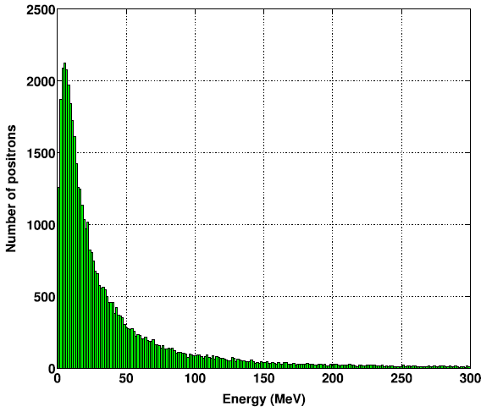
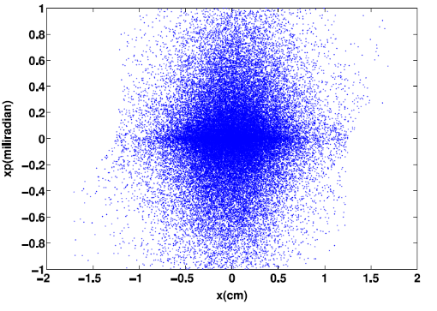
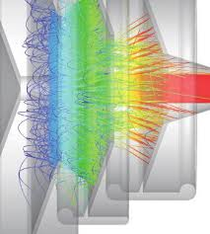
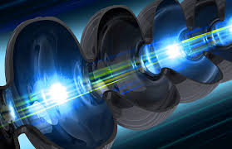
1. Project I
1.3 BD Simulations and Optimization of Acc. Structure
Positron sources provide normally beams with very large energy spread and emittance.
Existed PIC codes are not accurate and fast enough for these type of situations and optimizations.
Challenges
Complexity of calculations and simulations related to the influence of charged particle beams on RF field and vise versa.
Detailed beam dynamic studies.
Development of a new analytical model describing the physics behind such injectors is mandatory.
Requirements
Detailed study of beam-cavity interactions.
Advanced PIC simulations & programing.
5

