Slide 1
Photo-cathode RF Gun:
Cathode and Vacuum
In the name of Allah
Mostafa Salahshoor
22 Sep 2020
School of Particles and Accelerators - IPM

Slide 2
Content
Introduction
    Linac – Injector – Gun
    Electron Emission and Extraction Mechanisms
    Thermionic DC Gun vs. Photocathode RF Gun
Photocathode
    Three Step Model – Quantum Efficiency
    Classification – Properties
  Vacuum
    Describing Vacuum – Flow Regimes – Need for Accelerators
    Sources of gas loads – Outgassing
    Cathode Preparation, Transport & Characterization Systems

Slide 3
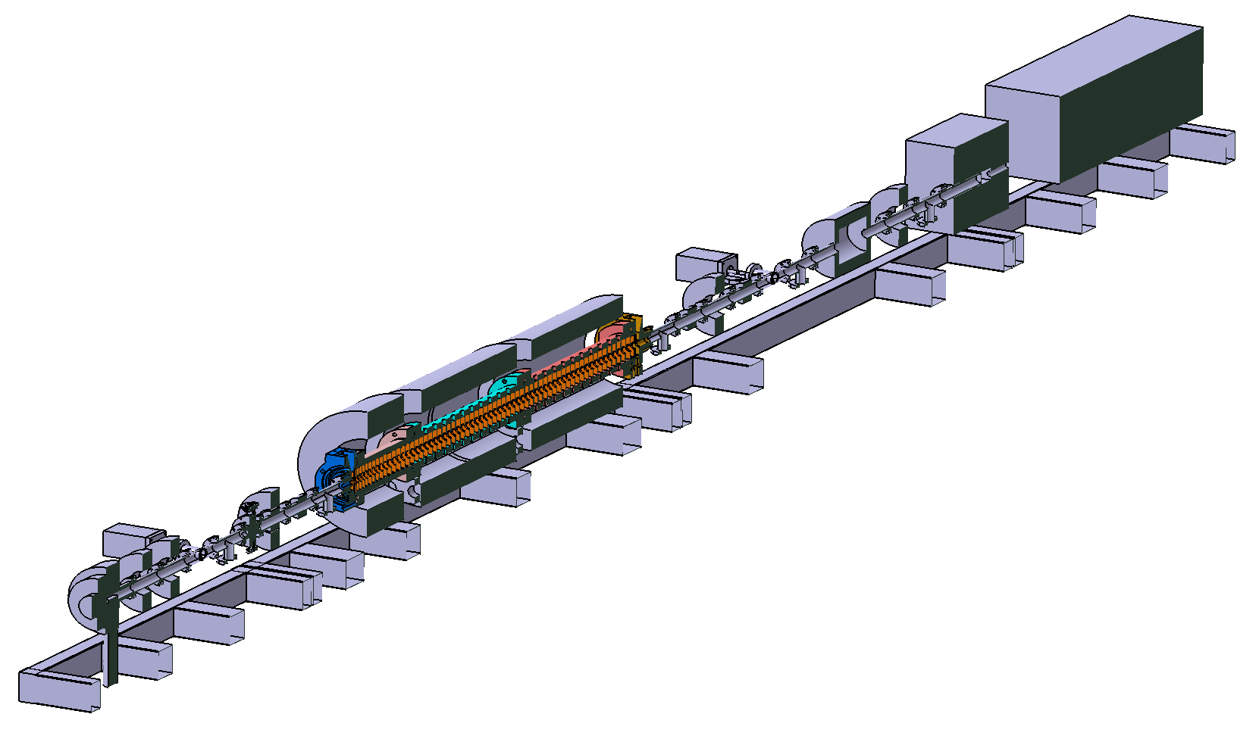
IPM Linac Layout
Injector

Slide 4
Injectors
Emission & Initial Acceleration
Thermionic cathode
Gridded-DC gun
DC gun
NCRF gun
Photo-electric cathode
DC gun
NCRF gun
SRF gun
Field-emission cathode
Pulsed-DC
RF
Pulsed-DC+
NCRF
Beam Conditioning
Emittance compensation
Solenoid focusing
RF focusing
Slice phase space matching
Ballistic compression
Fundamental & sub-harmonic RF
Inductive linac
Magnetic compression
RF harmonic linearizing
RF compression
Solenoid focusing
Tapered RF phase bunching
Acceleration
Capture into booster
Emittance preservation
Longitudinal phase space compensation
Chirping for bunch compressors
Gun

Slide 5
Electron Gun in Accelerators
Electron source or electron gun is a device which provides electrons for accelerators.
It essentially needs:
  an electron generation mechanism
  and an extraction mechanism.
Generation
Extraction

Slide 6
Electron Generation Mechanism
Give the conduction band electrons extra energy
  Thermionic Emission
  Photoelectric Emission (Photochathode)
  Secondary Emission
Change the potential barrier
  Field Emission or “tunneling”
  Plasma Emission

Slide 7
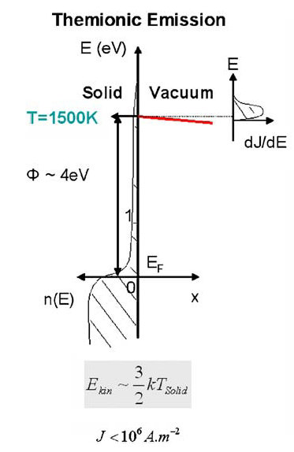
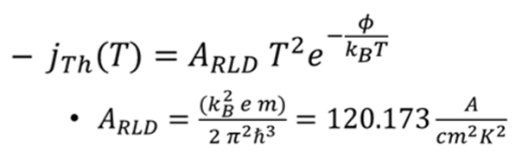
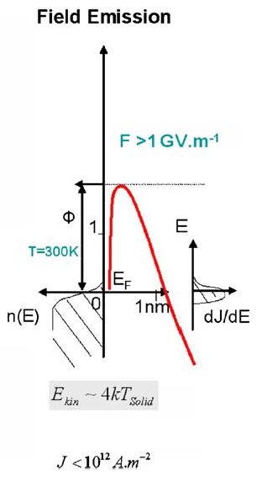
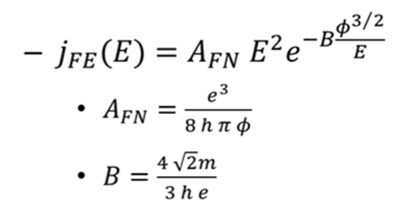
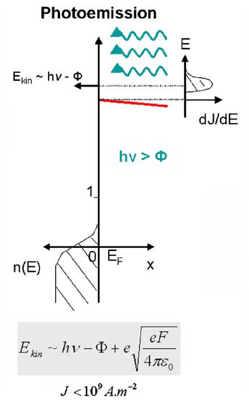

Emission Mechanisms
Thermal Emission
Richardson-Dushman
Field Emission
Fowler Nordheim
Photo Emission
Fowler-Dubridge

Slide 8
Thermionic and Field Emitters
Good for true DC and long pulse duration applications
The good points:
  Simple
  Low transverse emittance
  Tolerant of poor vacuum
  Long lifetime
However:
  Long bunches (100 ps+)
  Large longitudinal emittance
  Lack of control of profile
  Complicate Linac (Bunchers, Compressors)

Slide 9
Why use a Photo-Injector?
High peak current density ( 10^5 A/cm^2 )
Low emittance/temperature ( <0.2 μm‐rad )
Electron beam properties determined by laser
  Timing and repetition rate
  Spatial Profile
  Bunch length and temporal profile (Sub‐ps bunches are possible)

Slide 10


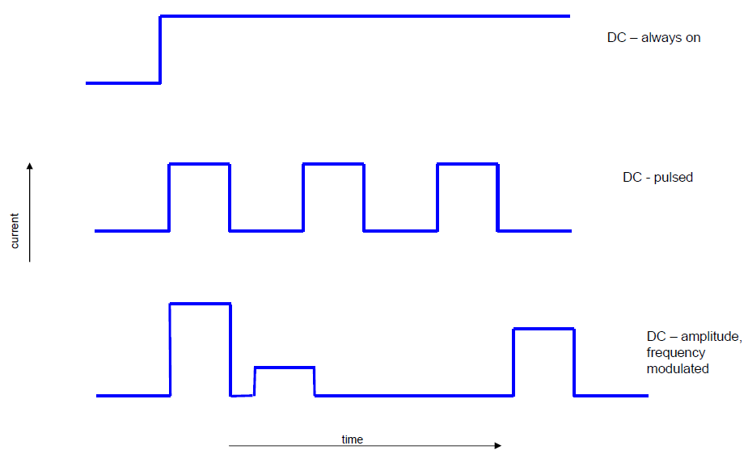
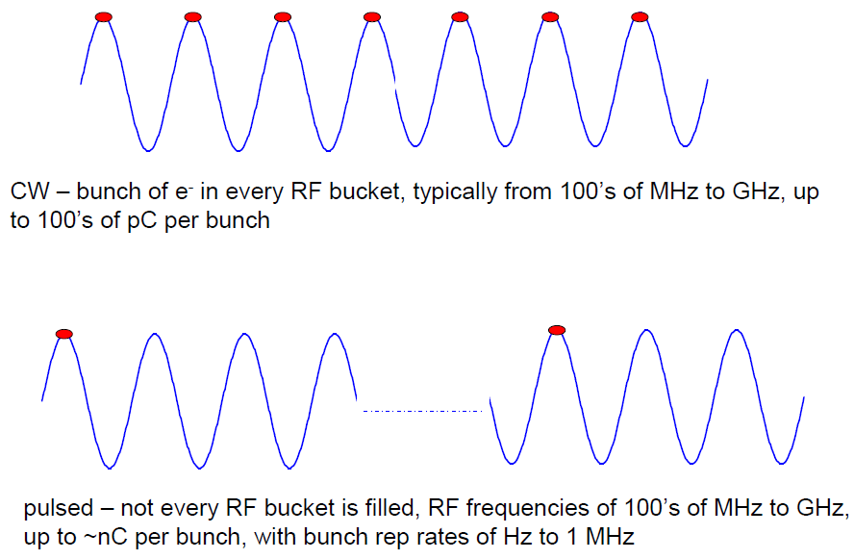
Electron Extraction Mechanism
DC RF

Slide 11
Thermionic DC Gun vs. Photocathode RF Gun
 | Thermionic DC Gun | Photocathode RF Gun
Type of emission | DC | Pulse
Current | High average current possible | High peak current possible
Post Buncher | Mandatory | Not needed
Output energy | few tens of KeV | MeV
Emittance per nC | ~ 10 -12 π-mm-mrad | <2 π-mm-mrad
Main usage | High current industrial, medical | Research accelerators

Slide 12
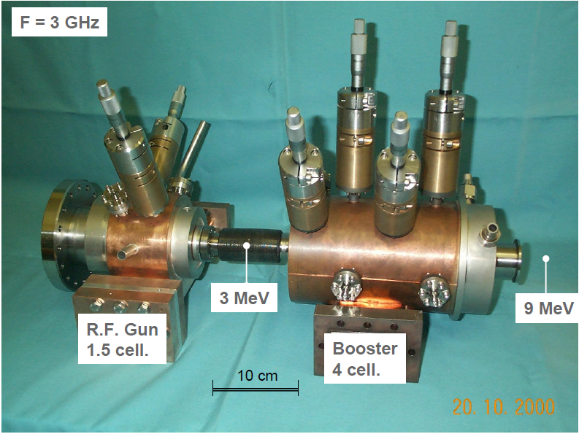
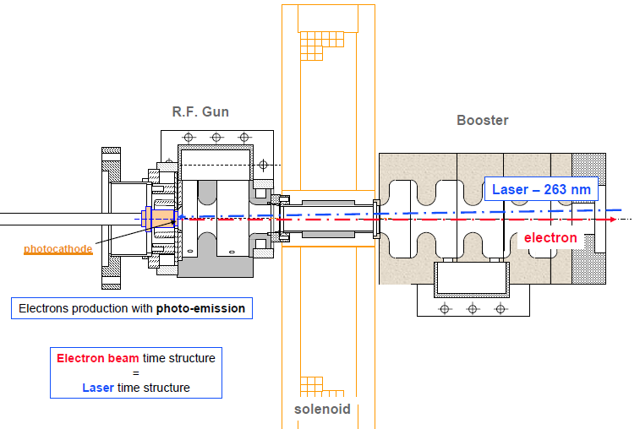
Photocathode RF Gun
ELYSE

Slide 13
Section II
Photocathode
    Three Step Model – Quantum Efficiency
    Classification – Properties

Slide 14
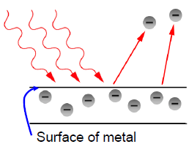
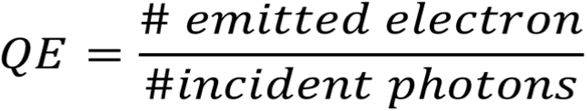

QE of Photocathodes
The efficiency of a photocathode is measured by its quantum efficiency :
@ 266 nm

Slide 15
Three-step model
Excitation of e⁻ in metal
  Reflection (angle dependence)
  Energy distribution of excited e⁻
2) Transit to the Surface
e⁻-e⁻ scattering
Direction of travel
3) Escape surface
Overcome Work function
Reduction of Φ due to applied
  field (Schottky Effect)
Vacuum level
hν
Φ
Empty States
Energy
?
Integrate product of probabilities over all electron energies capable of escape to obtain Quantum Efficiency
Filled States
Laser
Medium
Vacuum

Slide 16
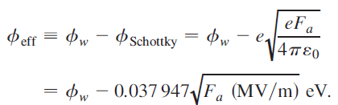
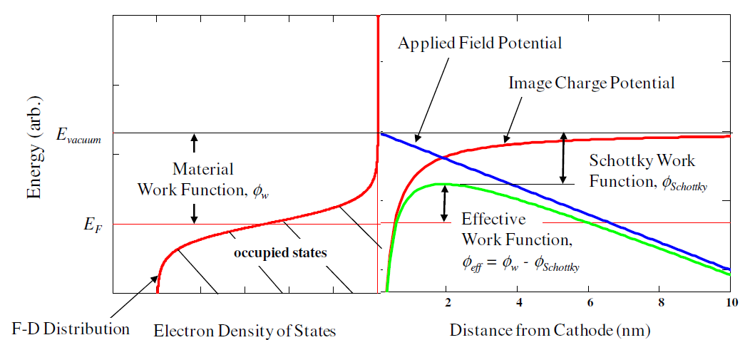
Schottky Effect
Under the RF field, the surface barrier of the emissive material is deformed to be lower. The generated electrons can be liberated to the vacuum more easily.

Slide 17
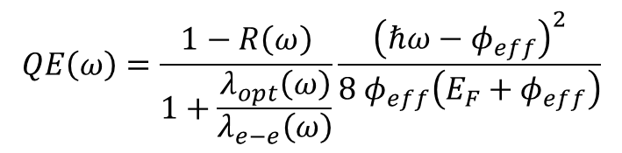
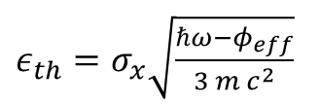
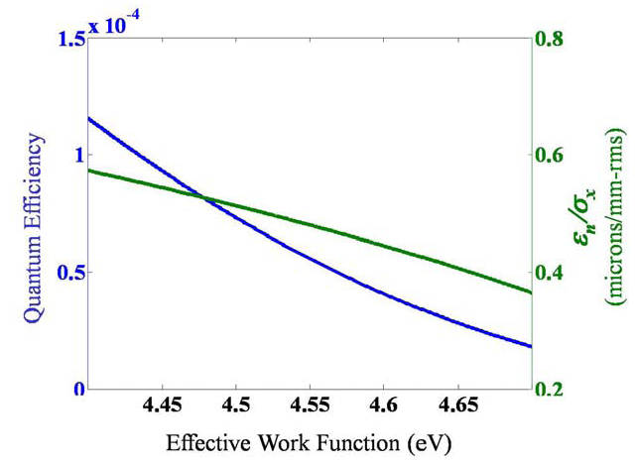
QE vs thermal emittance
QE and emittance have the same dependency on photon energy.
We can reduce emittance at the expense of very low QE.

Slide 18
Factors Affecting QE
Factor | Description
Reflection | Choice of polarization and angle of incidence Light traps (microstructures)
Nonproductive absorption | Semiconductor cathodes (especially NEA materials) Narrow valence band Work function reduction (Schottky effect, dipole layers)
Electron scattering (electron mfp) | Stay within the “magic window”, f<Eg<2Egap Minimize photon absorption length (surface plasmons) Good crystals – minimize defect and impurity
Deposition parameters | Substrate material, cathode thickness, sequential vs Co-deposition, substrate temperature, cooling time, oxide layer formation
Vacuum environment | Ion back-bombardment, electron stimulated desorption, chemical poisoning
Operating environment | Thermal stability, space charge

Slide 19
Factors Affecting Dark Current
Mechanism | Factors
Field emission | Electric field at cathode Surface morphology Work function
Thermal emission | Temperature Work Function
Ion bombardment | Vacuum Work function
Low work function reduces the threshold photon energy and improves QE, especially near threshold,
But, it increases dark current.
=> Optimal work function depends on application.

Slide 20
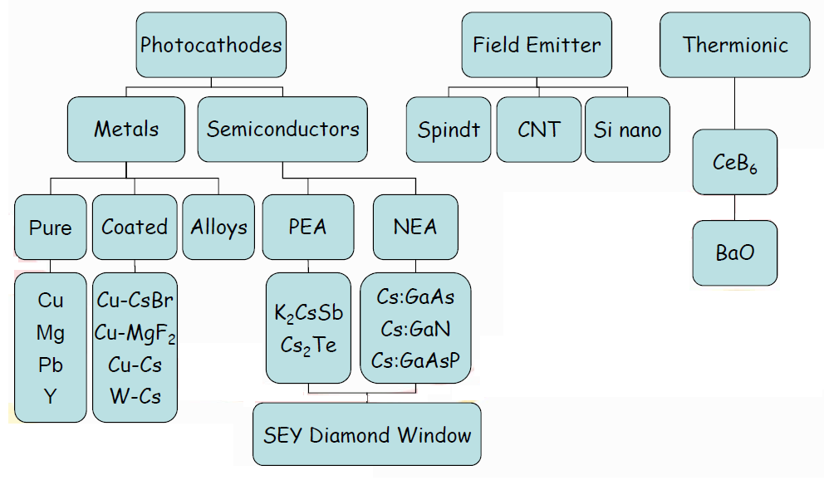
Cathodes for electron guns

Slide 21
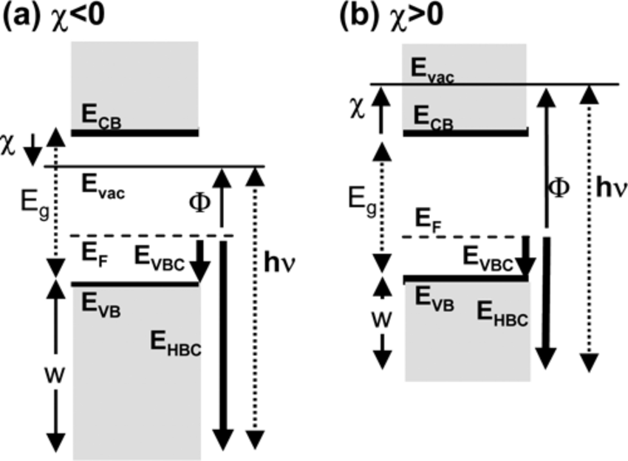

Positive Electron Affinity (PEA) Negative Electron Affinity (NEA)
Electron affinity = the energy released when an electron is attached to a neutral atom
NEA
PEA

Slide 22
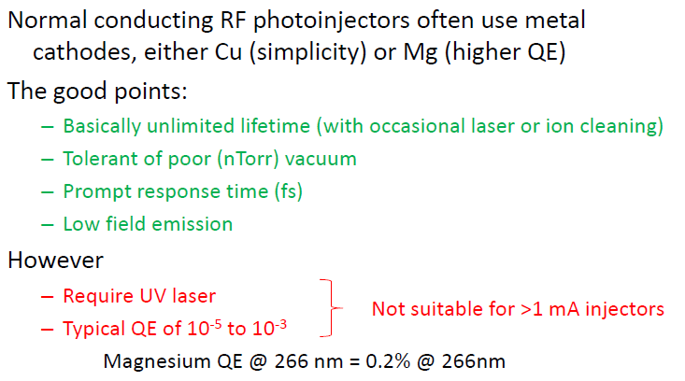
The Old Standby - Metals
Response Time: time required for excited electrons to escape
Lifetime: time required for QE to drop to 1/e of initial

Slide 23
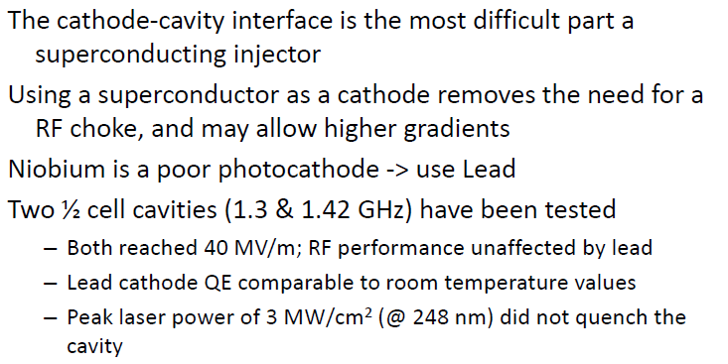
Superconducting Photocathodes

Slide 24
Properties of metal cathodes
Metal Cathodes | Wavelength & Energy: λ_{opt} (nm), ℏω (eV) | Quantum Efficiency (electrons per photon) | Vacuum for 1000h operation (Torr) | Work Function, φw (eV) | Thermal Emittance (microns / mm(rms)) Eq. (1) | Thermal Emittance (microns / mm(rms)) Expt.
Bare Metal
Cu | 250, 4.96 | 1.4 x 10⁻⁴ | 10⁻⁹ | 4.6 ^{[2]} | 0.5 | 1.0 ± 0.1 ^{[3]}
 |  |  |  |  |  | 1.2 ± 0.2 ^{[4]}
 |  |  |  |  |  | 0.9 ± 0.05 ^{[5]}
Mg | 266, 4.66 | 6.4 x 10⁻⁴ | 10⁻¹⁰ | 3.6 ^{[6]} | 0.8 | 0.4 ± 0.1 ^{[6]}
Pb | 250 , 4.96 | 6.9 x 10⁻⁴ | 10⁻⁹ | 4.0 ^{[2]} | 0.8 | ?
Nb | 250 , 4.96 | ~2 x 10⁻⁵ | 10⁻¹⁰ | 4.38 ^{[2]} | 0.6 | ?
Coated Metal
CsBr:Cu | 250 , 4.96 | 7 x 10⁻³ | 10⁻⁹ | ~2.5 | ? | ?
CsBr:Nb | 250 , 4.96 | 7 x 10⁻³ | 10⁻⁹ | ~2.5 | ? | ?

Slide 25
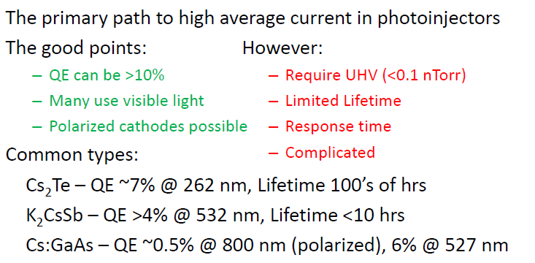
Semiconductor Photocathodes

Slide 26
Properties of semiconductor cathodes (PEA)
Cathode Type | Cathode | Typical Wavelength & Energy, λ_{opt} (nm), (eV) | Quantum Efficiency (electrons per photon) | Vacuum for 1000 h (Torr) | Gap Energy + Electron Affinity, E_{G}+E_{A} (eV) | Thermal Emittance (microns / mm(rms)) Eq. (2) | Thermal Emittance (microns / mm(rms)) Expt.
PEA: mono-alkali | Cs₂Te | 211, 5.88 | 0.1 | 10⁻⁹ | 3.5 ^{[7]} | 1.2 | 0.5 ± 0.1 ^{[8]}
 |  | 262, 4.70 | - | - | " | 0.9 | 0.7 ± 0.1 ^{[8]}
 |  | 262, 4.73 | - | - | " | 0.9 | 1.2 ± 0.1 ^{[9]}
 | Cs₃Sb | 432, 2.87 | 0.15 | ? | 1.6 + 0.45 ^{[7]} | 0.7 | ?
 | K₃Sb | 400, 3.10 | 0.07 | ? | 1.1 + 1.6 ^{[7]} | 0.5 | ?
 | Na₃ | 330, 3.76 | 0.02 | ? | 1.1 + 1.6 ^{[7]} | 0.4 | ?
 | Li₃Sb | 295, 4.20 | 0.0001 | ? | ? | ? | ?
PEA: multi-alkali | Na₂KSb | 330, 3.76 | 0.1 | 10⁻¹⁰ | 1 + 1 ^{[7]} | 1.1 | ?
 | (Cs)Na₃KSb | 390, 3.18 | 0.2 | 10⁻¹⁰ | 1 + 0.55 ^{[7]} | 1.5 | ?
 | K₂CsSb | 543, 2.28 | 0.1 | 10⁻¹⁰ | 1+1.1 ^{[7]} | 0.4 | ?
 |  | 532 |  |  |  |  | 0.56 ± 0.03 ^{[10]}
 | K₂CsSb(O) | 543, 2.28 | 0.1 | 10⁻¹⁰ | 1 + <1.1 ^{[7]} | ~0.4 | ?

Slide 27
Properties of semiconductor cathodes (NEA)
Cathode Type | Cathode | Typical Wavelength & Energy, λ_{opt} (nm), (eV) | Quantum Efficiency (electrons per photon) | Vacuum for 1000 h (Torr) | Gap Energy + Electron Affinity, E_{G}+E_{A} (eV) | Thermal Emittance (microns / mm(rms)) Eq. (2) | Thermal Emittance (microns / mm(rms)) Expt.
NEA | GaAs(Cs,F) | 532, 2.33 | 0.1 | ? | 1.4 ± 0.1 ^{[7]} | 0.8 | 0.44 ± 0.01 ^{[11]}
 |  | 860, 1.44 | 0.1 | ? |  | 0.2 | 0.22 ± 0.01 ^{[11]}
 | GaN(Cs) | 260, 4.77 | 0.1 | ? | 1.96 + ? ^{[11]} | 1.35 | 1.35 ± 0.1 ^{[12]}
 | GaAs(1-x)Px x~0.45 (Cs,F) | 532, 2.33 | 0.1 | ? | 1.96 + ? ^{[11]} | 0.49 | 0.44 ± 0.1 ^{[11]}
S-1 | Ag-O-Cs | 900, 1.38 | 0.01 | ? | 0.7 ^{[7]} | 0.7 | ?

Slide 28
Summary of Cathodes Properties
PEA Cathodes
Work in visible light
High QE (>1%)
Good response time (<1ps)
Need very good vacuum (~10⁻¹⁰ torr or better)
Metal Cathodes
Good response time (<<1ps)
Very robust and insensitive to vacuum
Very low QE (<0.01%)
Need UV light
NEA Cathodes
Work in visible light
High QE (>10%)
Possible to attain sub-thermal mean transverse energies
Need very good vacuum (~10⁻¹² torr or better)
Response time very long (~100ps) in IR/red wavelengths, but less than 1ps in green

Slide 29
Section III
Vacuum
    Describing Vacuum – Flow Regimes – Need for Accelerators
    Sources of gas loads – Outgassing
    Cathode Preparation, Transport & Characterization Systems

Slide 30
Vacuum
= sub-atmospheric pressure.
The force exerted on the walls of an evacuated vessel surrounded by atmospheric pressure is: 1 kg/cm2
 | Pa | kg/cm² | Torr | mbar | bar | atm
1 Pa | 1 | 10.2 10⁻⁶ | 7.5 10⁻³ | 10⁻² | 10⁻⁵ | 9.81 10⁻⁶
1 kg/cm² | 98.1 10³ | 1 | 735.5 | 980 | 0.98 | 0.96
1 Torr | 133 | 1.35 10⁻³ | 1 | 1.33 | 1.33 10⁻³ | 1.31 10⁻³
1 mbar | 101 | 1.02 10⁻³ | 0.75 | 1 | 10⁻³ | 0.98 10⁻³
1 bar | 1.01 10⁵ | 1.02 | 750 | 10³ | 1 | 0.98
1 atm | 101 300 | 1.03 | 760 | 1 013 | 1.01 | 1

Slide 31
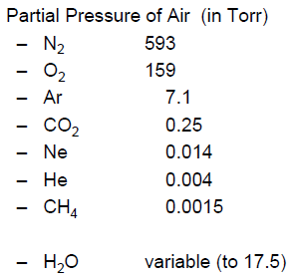
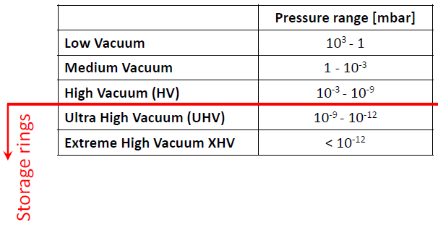
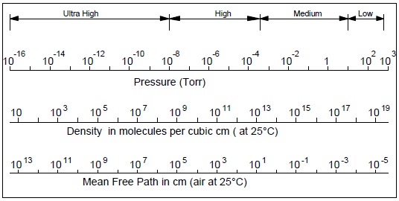
Describing Vacuum

Slide 32
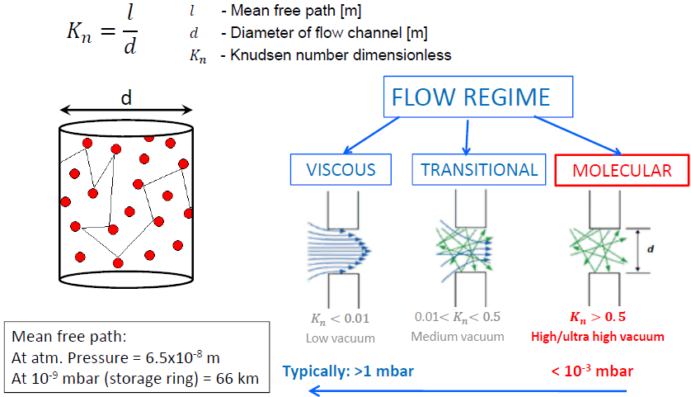
Flow Regimes
Re > 2000 | turbulent
Re < 1000 | viscous

Slide 33
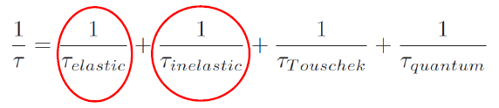
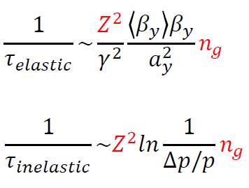
Why do we need vacuum in particle accelerator?
Less beam-gas interaction:
  Increase beam lifetime,
  Prevents to increase beam size,
  Reduces radiation hazard,
  Lowers background in detectors.
The total beam lifetime in a particle accelerator is given by:
Not only the absolute pressure is important but also what are the gas species in the system

Slide 34
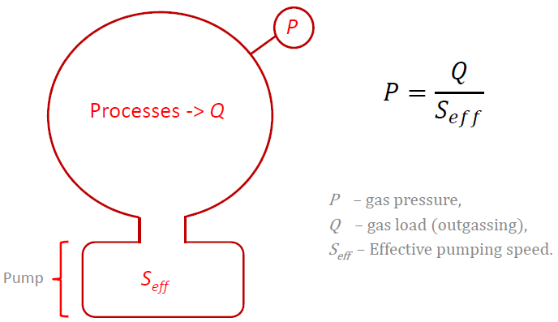
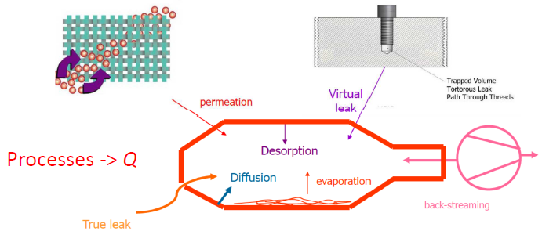
Sources of gas loads
Generic vacuum system
Sources of static gas loads
in vacuum system:

Slide 35
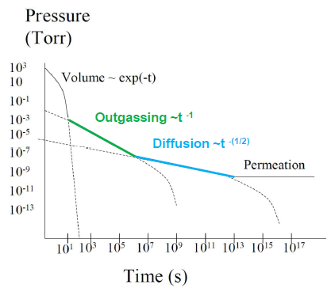
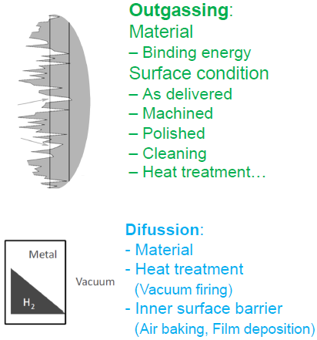
What process defines the pressure over time?

Slide 36
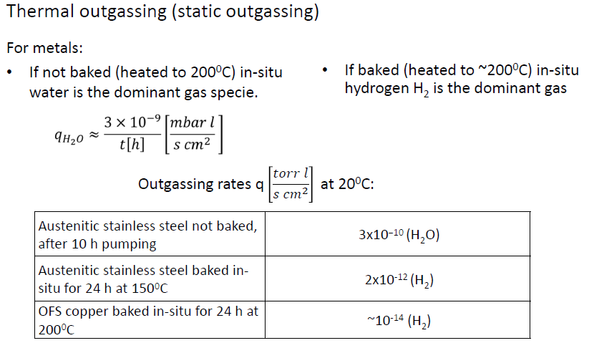
Thermal Outgassing

Slide 37
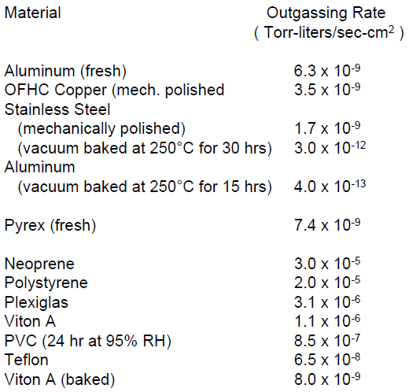
Outgassing Rates

Slide 38
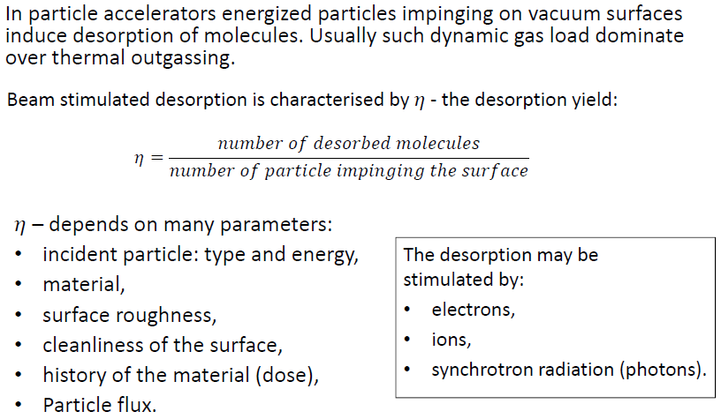
Dynamic Outgassing

Slide 39
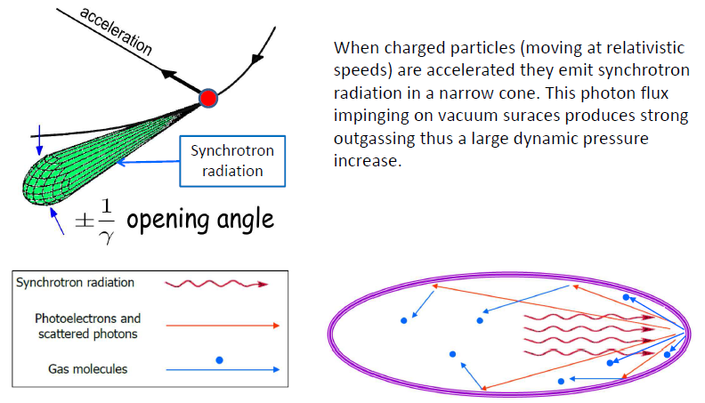
Photon Stimulated Desorption

Slide 40
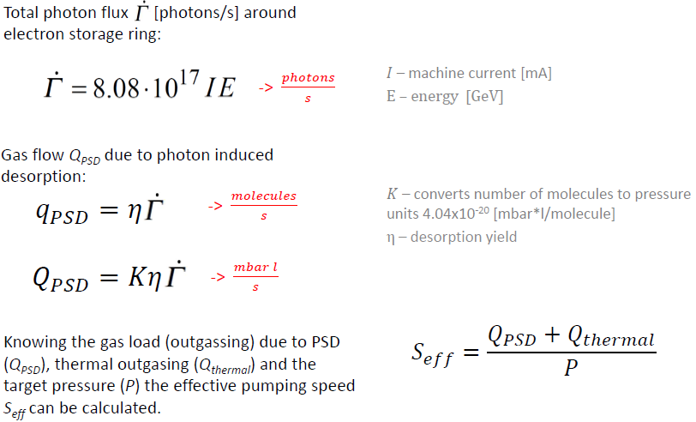
Photon Stimulated Desorption

Slide 41
Vacuum Systems
Vacuum Pumps (molecular regime)
  Momentum transfer pumps
    Turbo Molecular Pump
  Capture pumps (getters)
    evaporable getters (Titanium Sublimation Pump - TSP)
    non-evaporable getters - NEG (Sputter ion pumps)
Vacuum Gauges
Vacuum Valves
Other Vacuum Components (Flange, Gasket, …)

Slide 42
Vacuum Requirements Related to Photocathode RF Gun
Semiconductor and
coated metal cathodes
Cathode Preparation System
Cathode Manipulation and Installation System
Cathode Transport System
Cathode Characterization System
Cathode Performance and Life Time
RF Breakdown

Slide 43
Cs2Te Cathodes production and use

Slide 44
Cathodes production and use: substratum

Slide 45
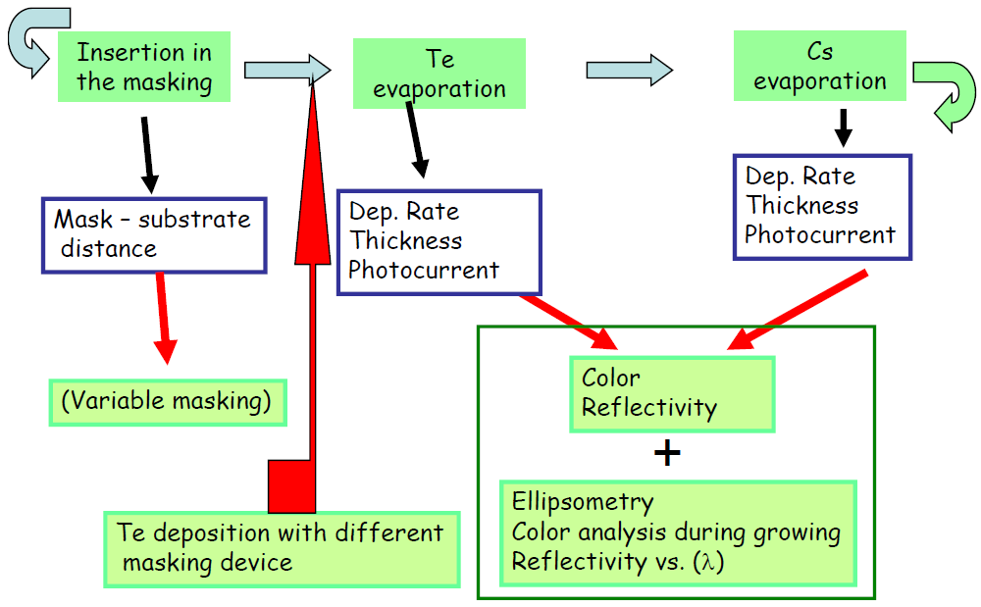
Cathodes production and use: evaporation

Slide 46
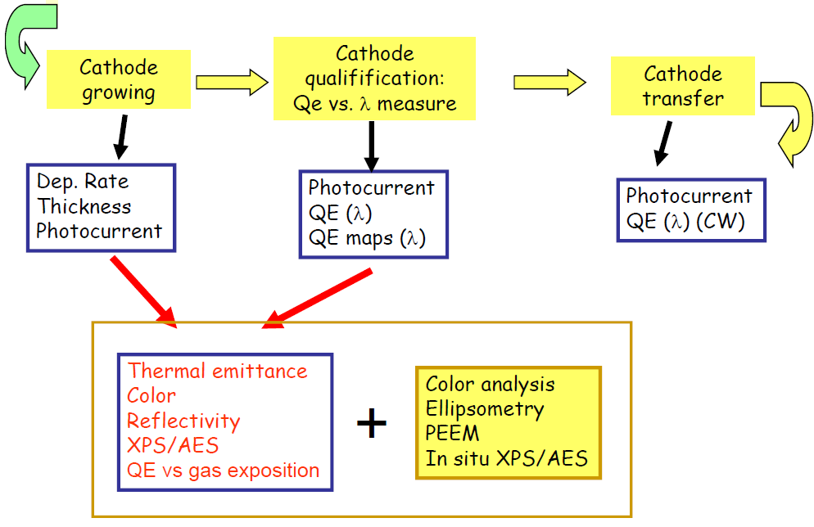
Cathodes production and use: growth

Slide 47
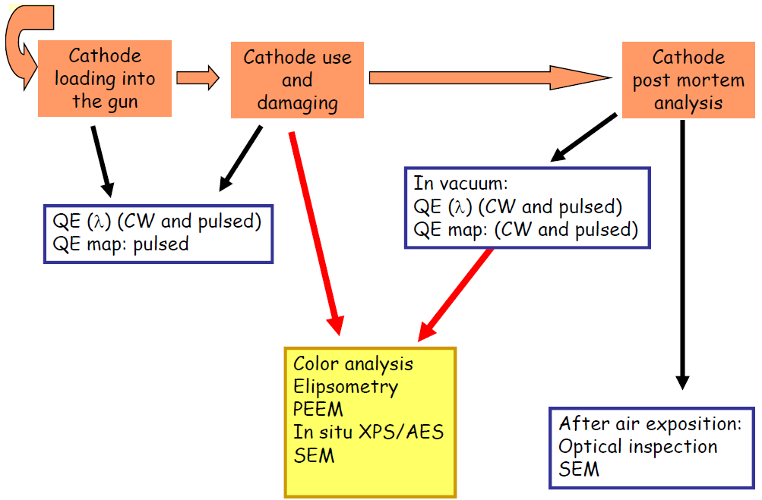
Cathodes production and use: gun operation

Slide 48
Photocathodes Studies @ FLASH
Photocathode inserted into the gun backplane

Slide 49
Photocathode Production: Preparation Chamber
Photocathodes are grown @ LASA on Mo plugs under UHV condition.

Slide 50
Production: from Mo plugs ...

Slide 51
Production: ... to photocathodes growth

Slide 52
Characterization: diagnostic on photocathodes

Slide 53
Transport: from LASA to FLASH and PITZ

Slide 54
CW QE measurements: Experimental set-up

Slide 55
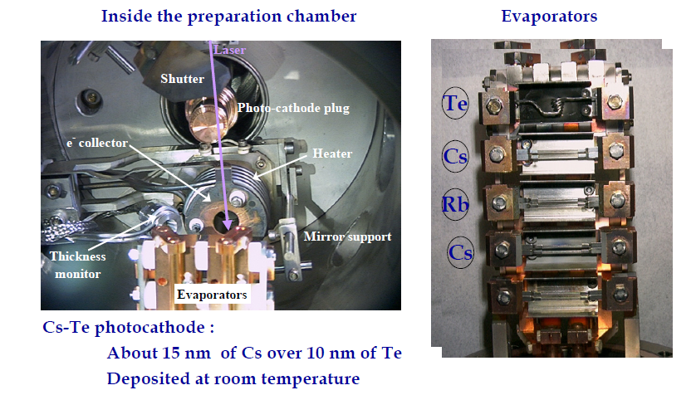
Standard evaporation process

Slide 56
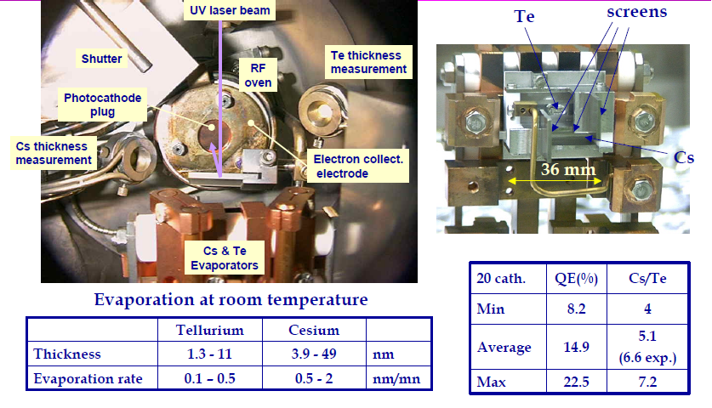
Co-evaporation process

Slide 57
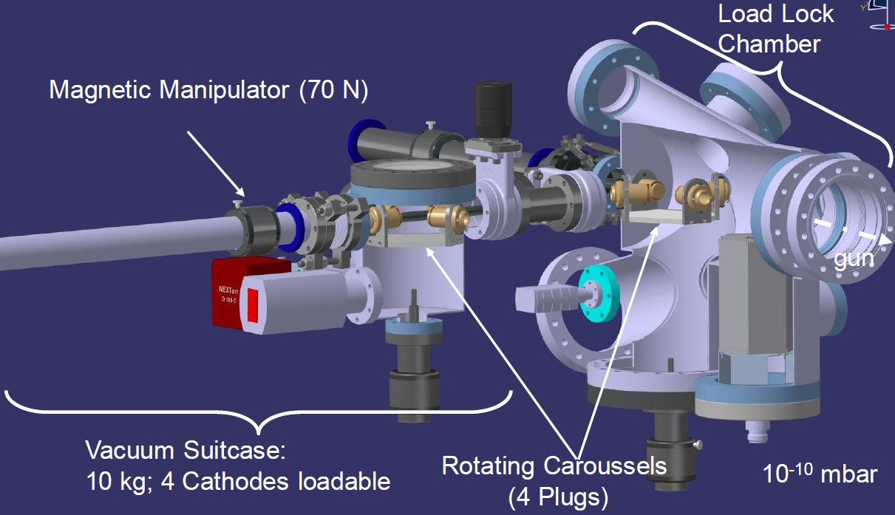
SwissFEL LOAD-LOCK SYSTEM

Slide 58
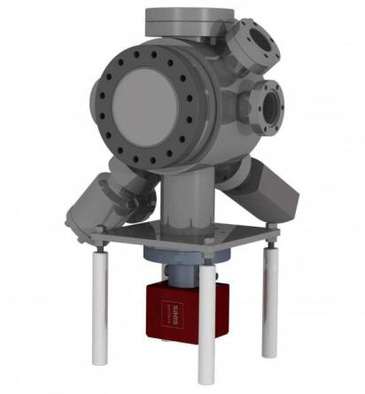
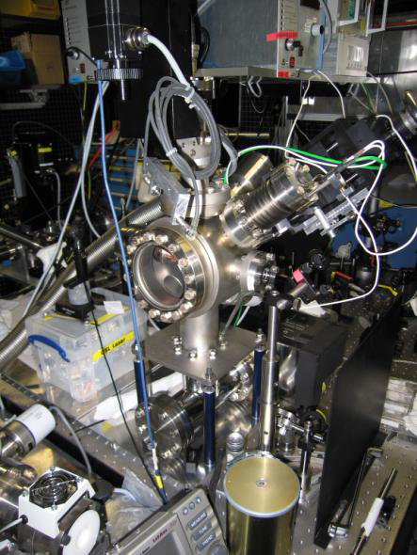
Preparation chamber
where cathodes can be cleaned, annealed and where the quantum efficiency (QE) can be checked.

Slide 59
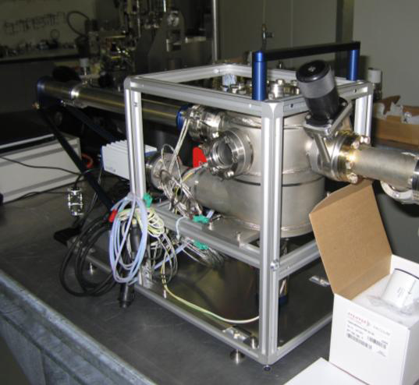
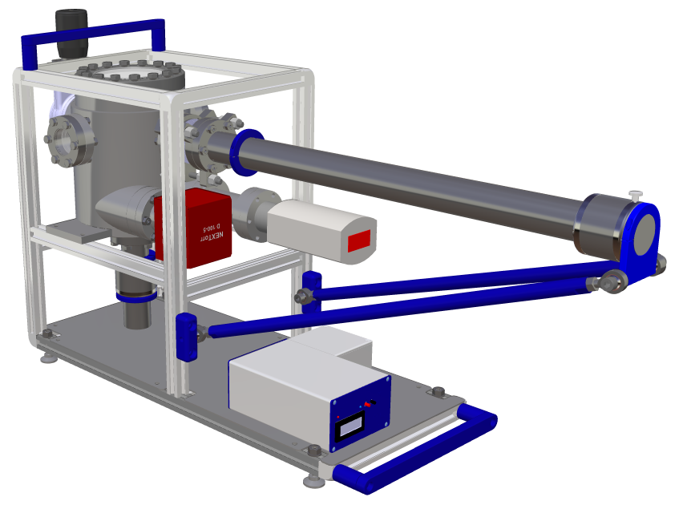
Vacuum suitcase
where cathode plugs can be loaded from preparation chamber and transported to the gun.

Slide 60
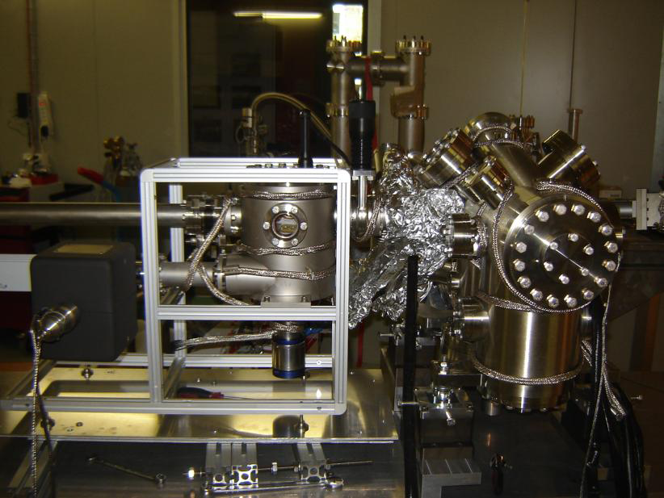
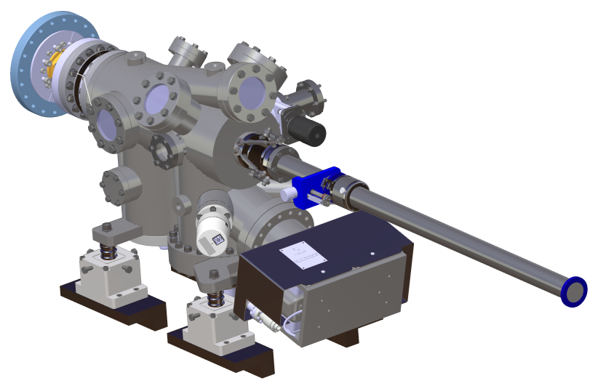
Gun loading chamber
which is permanently attached to the gun and in which cathodes can be transferred from vacuum suitcase to the gun backplane.

Slide 61
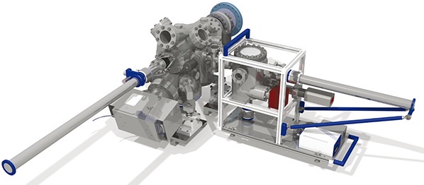
SwissFEL LOAD-LOCK SYSTEM

Slide 62
Preparation System – Instrumentation Requirements
QE measurement system
laser + chopper wheel + lock-in amp + photodetector - Used to shine light of known power on the cathode. The Lockin-amp +chopper not required if background light is negligible.
Current measurement - Electrons emitted from the cathode can be collected in a electrode placed close to the cathode surface at a certain bias (~100V). Alternatively, if the sample is floated, the electron current emitted can also be measured by recording the current flowing into the sample. The ammeter should be capable of reading currents from pA range to the uA range.
Quartz Micro Balance (QMB)
Used to estimate the mass of the material deposited. Ideally this should be placed in a position which sees the same flux of material as the substrate.

Slide 63
Preparation System - Instrumentation Requirements
Vacuum Monitoring
RGA - Records the partial pressures of various residual gases in the chamber
Cold cathode gauge /Ion gauge - Records the total pressure in the prep chamber
Thermocouple + heater - Used to control temperature of the substrate.

Slide 64
Survivability and Lifetime: Cathode Contamination
Three sources of cathode contamination
Residual contaminants left by fabrication, handling and storage
Contamination and damage by the RF gun and laser
  Ambient vacuum
  Operating vacuum
  Cathode cleaning
Contamination during operation due to molecular cracking:
  By the laser
  By the electron beam
Toward problem solution
Cathode exchange (last choice)
Cathode restoration
  Laser Cleaning
  Surface sputtering
  UV/Ozone Cleaning (from the beamline experience)

Slide 65
Thank You

