Slide 1
Chiral vortical and magnetic effects on hypermagnetic fields and matter-antimatter asymmetries
Shiva Rostam Zadeh
October 28, 2020
Phys.Rev. D100 (2019) no.11, 116022

Slide 2
Content
Baryogenesis and magnetogenesis
Chiral magnetic effect (CME)
Chiral vortical effect (CVE)
CVE and CME in AMHD equations
Abelian anomaly and matter asymmetries
Right-handed electrons
Results and conclusion

Slide 3
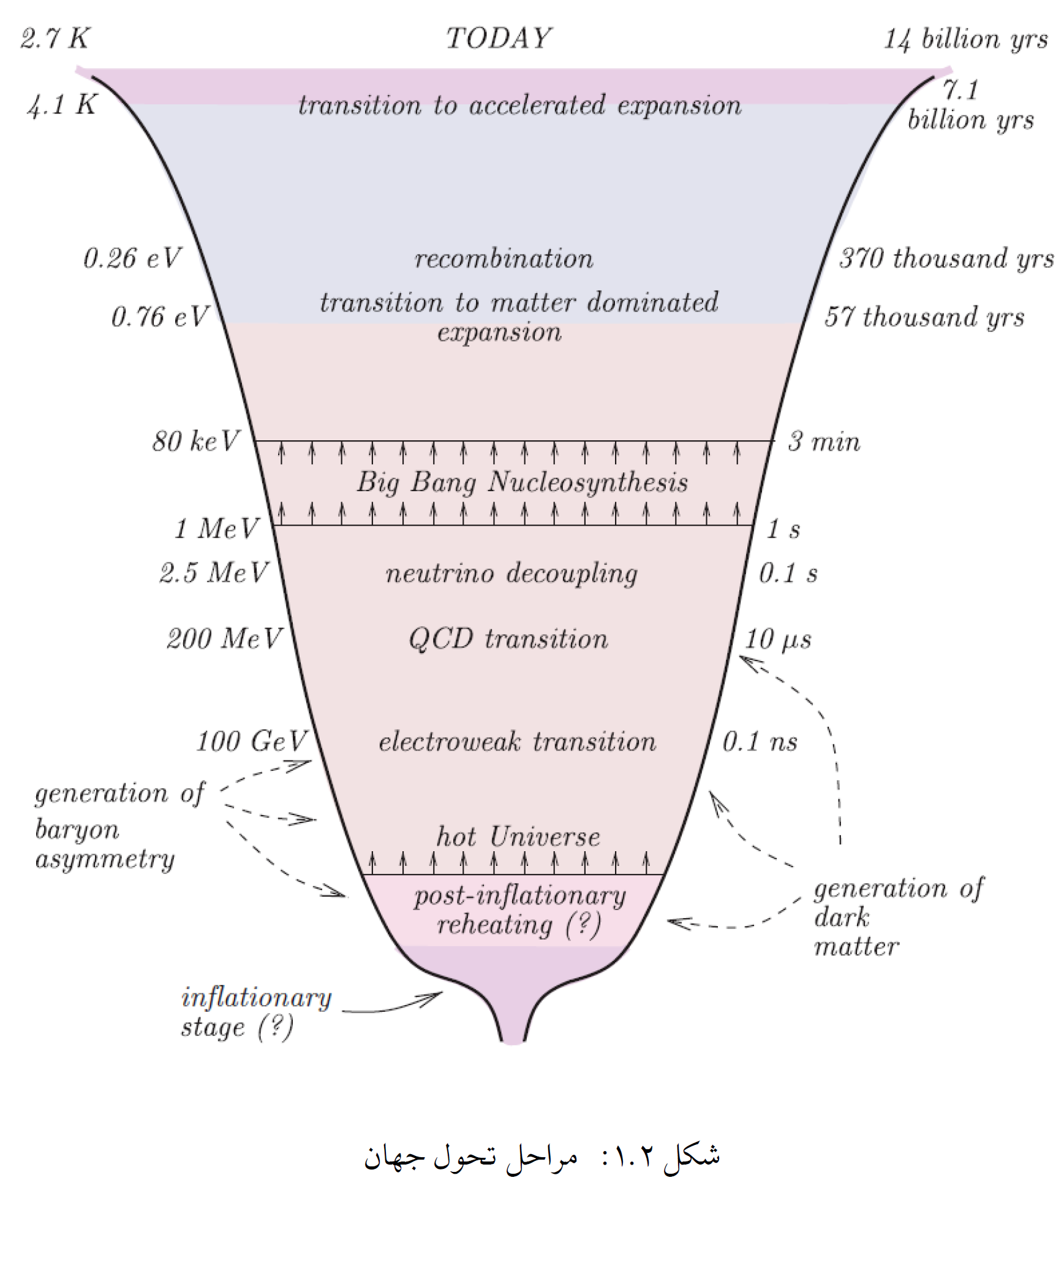

Slide 4



Observational Data
Baryon asymmetry of the Universe
BBN and CMB:
Large scale magnetic fields
Gamma rays from blazars:

Slide 5
Sakharov Conditions for Baryogenesis:
B violation
C and CP violation
Departure from thermal equilibrium

Slide 6

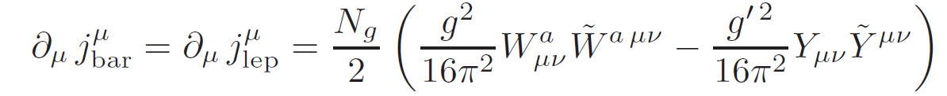
The Chiral Coupling of to Fermions
Anomaly leading to fermion number violation
The chiral vortical and magnetic effects

Slide 7
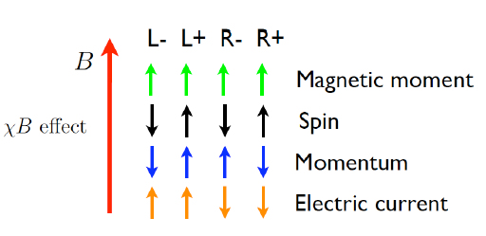


Chiral magnetic effect (CME)
The CME is the generation of the electric current parallel to an external magnetic field.

Slide 8
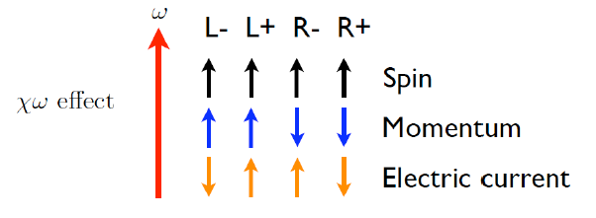

Chiral vortical effect (CVE)
The CVE is the generation of the electric current along the vorticity field.

Slide 9
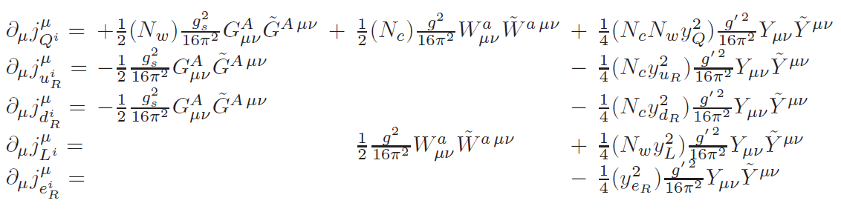


Anomaly equations in the symmetric phase of the MSM

Slide 10



Right-handed Electrons
Chirality flip processes
are out of thermal equilibrium For .
6

Slide 11

The Scenario
Baryon and the first-generation lepton asymmetries
Large scale hypermagnetic fields
Abelian anomaly
CVE and CME
Chirality flip processes
7

Slide 12
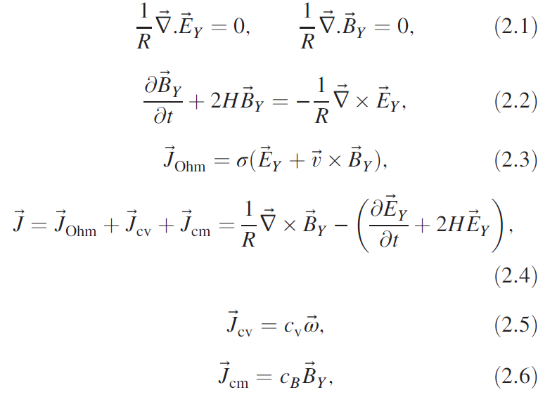
AMHD equations

Slide 13
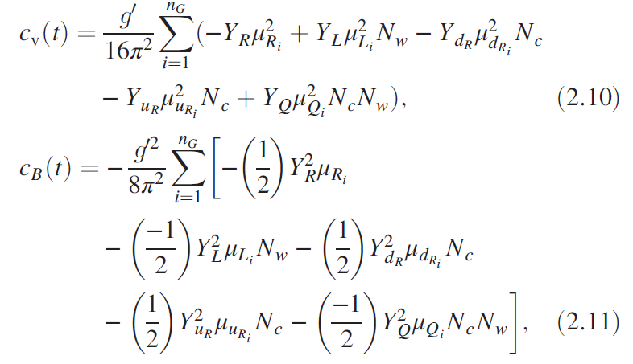
Chiral vortical and magnetic coefficients

Slide 14
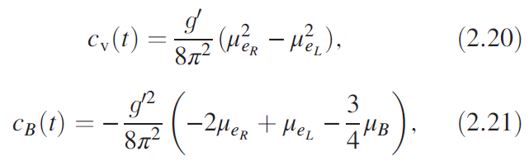

Slide 15
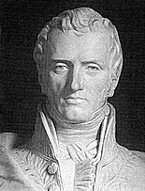
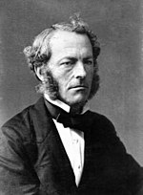
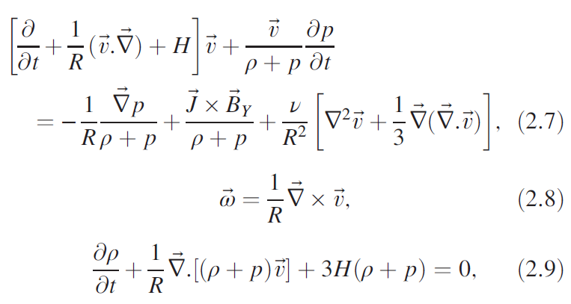
Navier-stokes equations

Slide 16


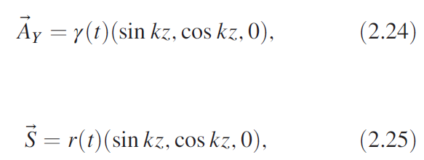
Chern-Simons configuration
Incompressible fluid:
and continuity equation result in

Slide 17



The evolution equations of hypermagnetic and velocity fields

Slide 18
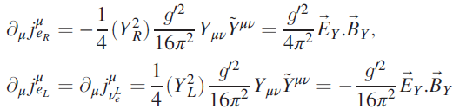
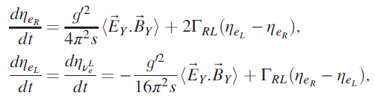

Abelian anomaly equations

Slide 19
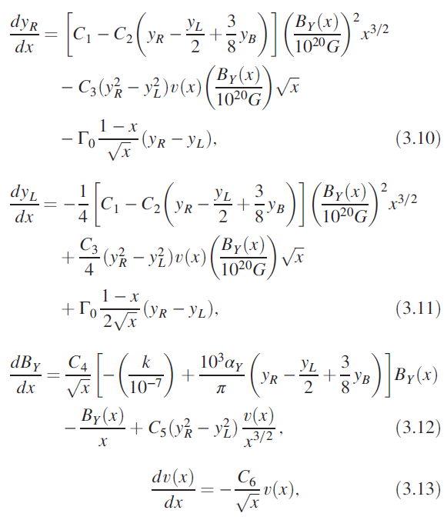
Evolution equations

Slide 20
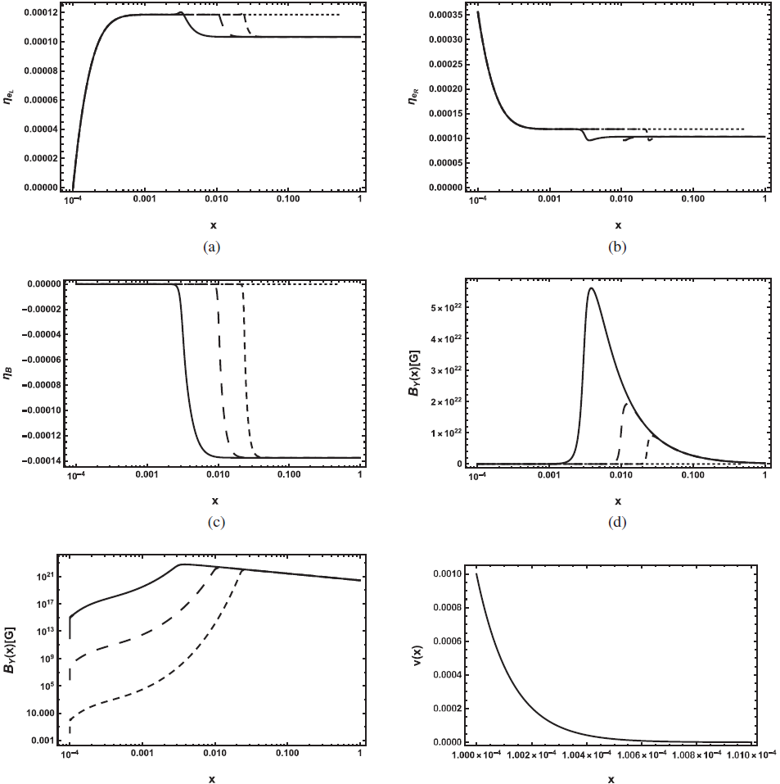

Slide 21
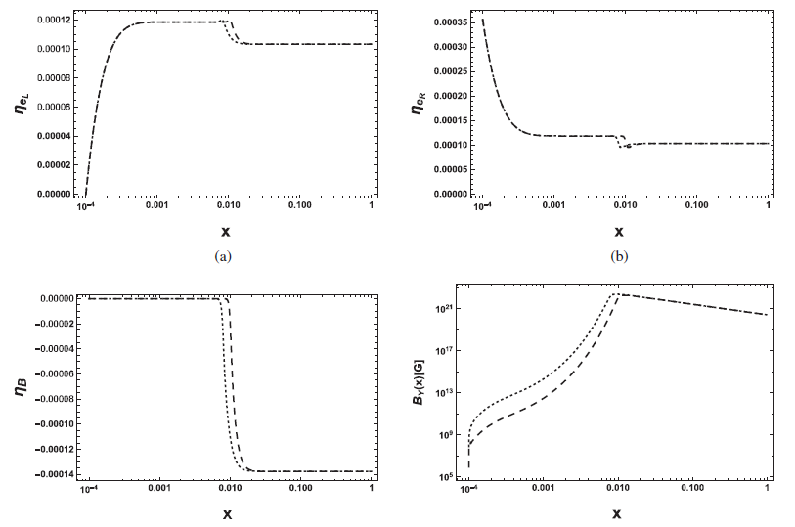

Slide 22




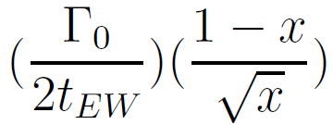



Slide 23

Right-handed electrons
Encode the baryon asymmetry in a right-handed electron asymmetry protected from the weak sphalerons down to .

Slide 24
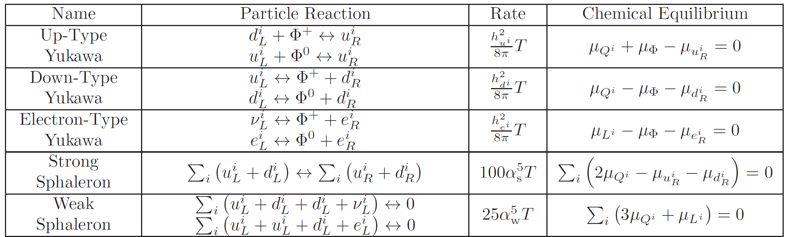

Slide 25
Thanks for your attention

